Slide 1
Hexham Rd
Off Site Tree Strategy
Updated July 2026
Full planning application for the erection of a building containing a day centre providing social care services (Use Class E(f)) and 42 residential units including specialist housing (Use Class C3) with landscaping, car parking and access (s.73 application to vary Conditions 2, 13, 14, 21 & 22 of permission 23/0279).” approved 14 October 2025 (reference PL/24/1589).
This application has been submitted to discharge condition 25 which requires an off-site tree planting strategy to be approved prior to occupation of the development. The locations identified in this report are based on an initial appraisal/ desktop visual analysis of the streetscape and are potentially suitable for trees of this size.
The proposals mitigate the loss of trees within the site boundary, however, to further mitigate against the canopy loss and to improve the local area amenity, it is proposed to plant 10 trees within the local area of the site. In line with the Biodiversity Net Gain Assessment submitted through the planning permission, a total of 0.12 biodiversity units will be delivered through off-site planting of ten moderate trees.
This document illustrates 15 possible locations, including 5 reserve sites, which have been agreed by RBC’s Street Scene Teams. There may be required some adjustment in case the contractor find unidentified underground services. We are not anticipating any conflict with service routes, but reserve sites have been included should any locations not be suitable.
Map and views taken from Google Maps. The locations are contingent on local conditions being acceptable.
The trees will be selected from the following species.
Acer campestre Lienco
Amelanchier arboria ‘ Robin Hill’
Betula utilis
Betula Albosinensis ‘ Fascination’
Betula papyrifera
Liquidambar styracilflua ‘Worplesdon’
Pyrus calleryana Chanticleer
Ulmus New Horizon

Slide 2
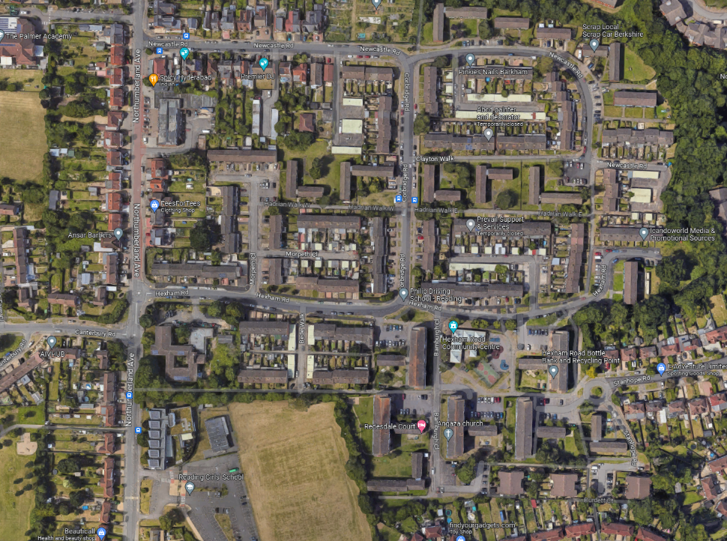
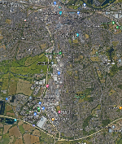
2
1
6
7
Proposed Locations.
3
5
4
9
10
8
12
13
11
Keyplan of Reading
Tree location
14
15
Reserve Tree location

Slide 3
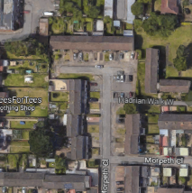
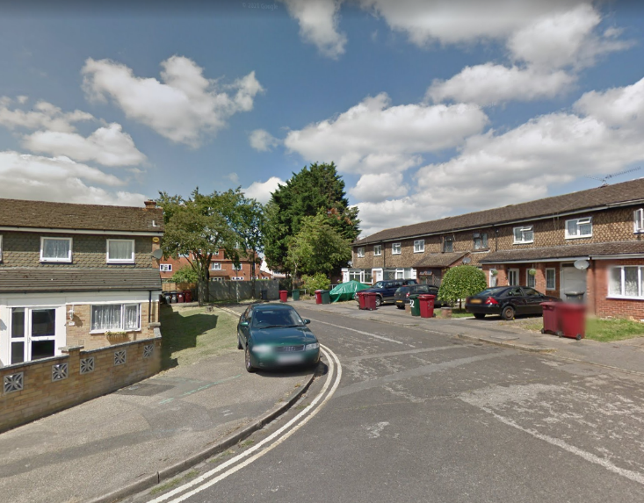
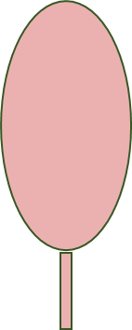
2
1
1
2
Location 1,2
Species
1&2 -Acer campestre Lienco
Site notes
Bank to north of property but there is a wide flat section at the top and the light levels are fair.
Planting position: two trees at 6m centres 2m from back edge of pavement.
Leaves 8m to utility cabinet and 19m to junction.
Street View

Slide 4
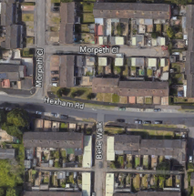
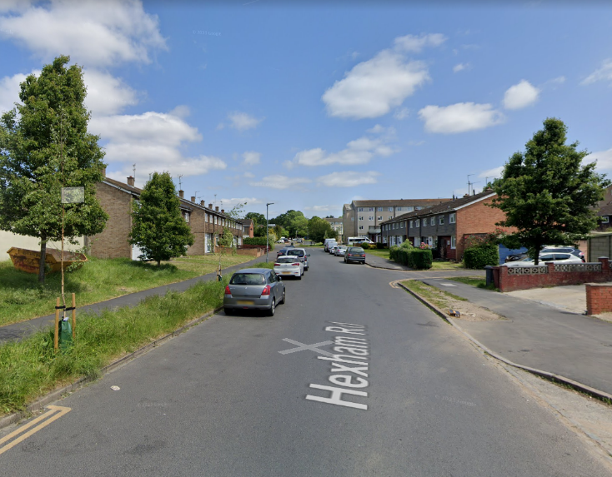
4
3
Location 3 ( Reserved location)
Species
3 - Amelanchier arboria ‘ Robin Hill’
Site notes
Roadside verge with recent plantings nearby.
Planting position: 6m west from l/c 6825, 6m east from recently planted birch.
Street View

Slide 5
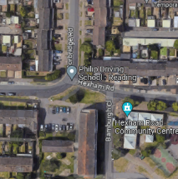
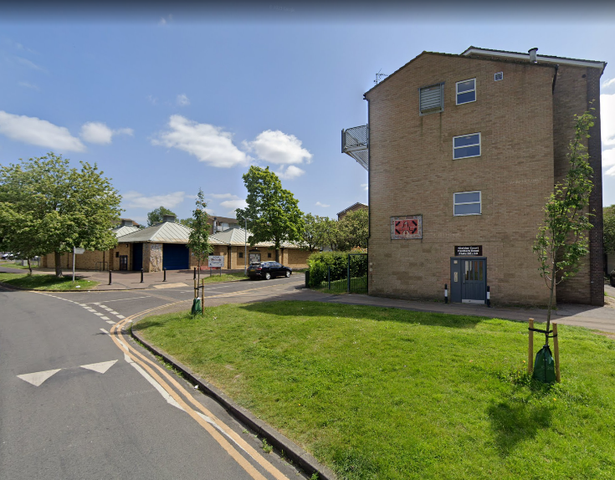
5
4
4
5
Location 4 & 5
Species
4 - Liquidambar styracilflua ‘Worplesdon’ 5 - Pyrus calleryana Chanticleer
Site notes
Open, wide verge. Several plantings present, but room for two trees without conflict with existing trees.
No.4 -Space available as the young tree is dead.
No.5 Planting position: 2m from back edge of footway; 5m in eastern end of verge. In line with existing cherry.
No utilities visible, no apparent trenching.
5m
2m
Street View

Slide 6
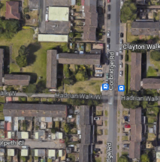
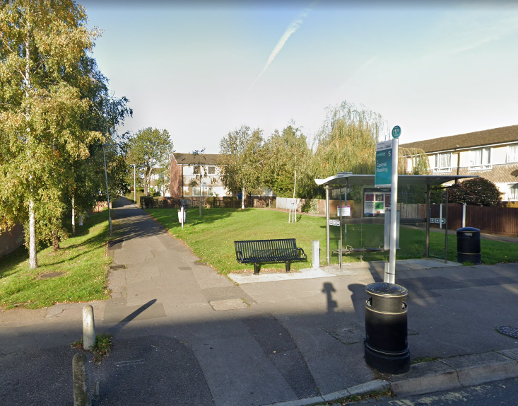
6
7
6
7
Location 6, 7
Species
6 – Betula Albosinensis ‘ Fascination’
7 – Betula papyrifera
Site notes
Possible locations are indicated with red arrows on the map. Hadrian walk area has been landscaped with birch species and suitable to maintain the same Genus however using different species provide different characteristics and diversity.
Street View

Slide 7
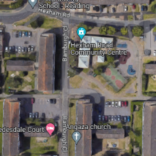
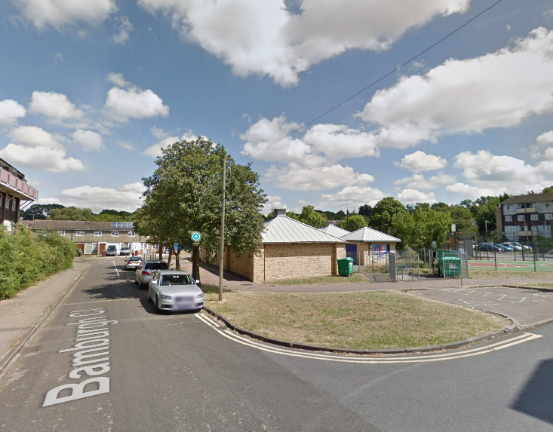
8
8
Location 8
Species
8 - Ulmus New Horizon
Site notes
Space to take a slightly larger species.
Planting position: centre of grass area
Leaves several metres to each kerb edge
Utility cover in grass
Position of overhead phone line
Street View

Slide 8
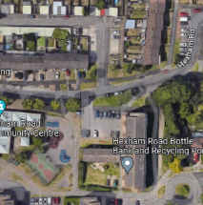
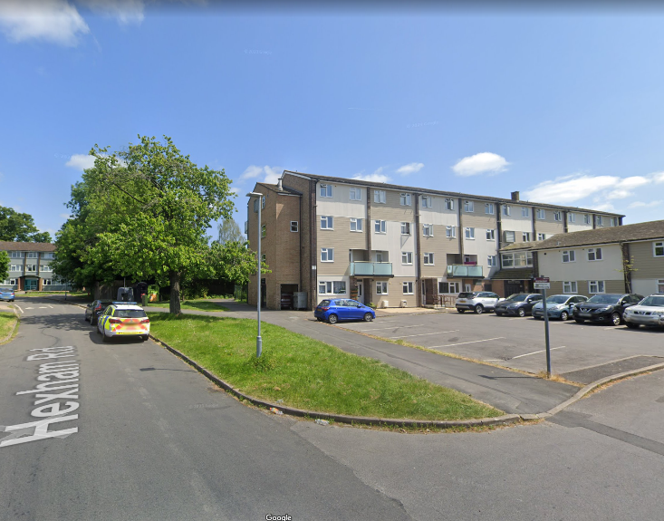
9
10
9
10
Location 9, 10
(10 is reserved s) location
Species
9 - Acer X Freemanii ‘Autumn Blaze’
10 – Crataegus monogyna Stricta
Site notes
9 - space to take a slightly larger species.
10 – narrower form would fit space better.
Planting positions:
9. 1.75m from back edge, 5m from l/c 6846
10. To front of Denton Court in grass strip ( Reserved site)
1.75m
5m
Street View

Slide 9
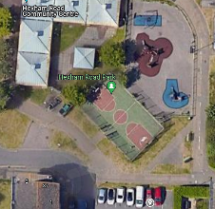
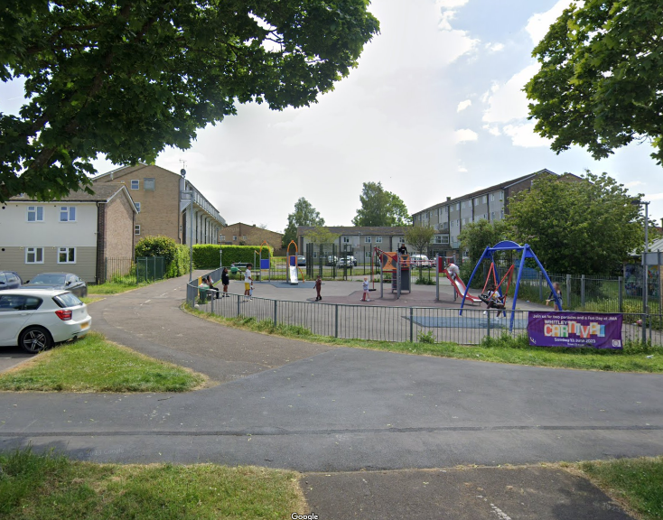
12
13
11
11
12
13
Location 11, 12, 13 ( all reserved location)
Species
11 –Amelanchier arboria ‘ Robin Hill’
12 –Prunus Sunset Boulevard
13 –Acer x freemanii cultivar
- ‘Autumn Fantasy’
Site notes
Several positions where the shade would be welcome for people sitting on the bench or using the MUGA/park, without overhang. Use high stakes and guards as likely vandalism.
Planting positions:
11. Southern verge right angels to benches
12. Grass strip to SE of MUGA fence, to corners of MUGA
13. Grass strip to SE of MUGA fence, to corners of MUGA
All reserved locaitons
Street View

Slide 10
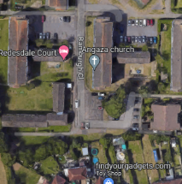
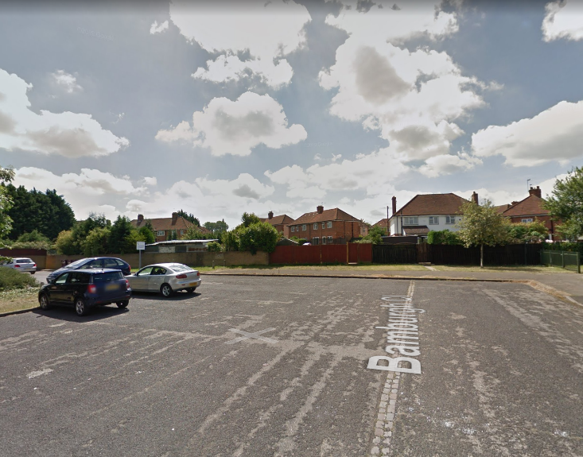
14
15
Location 14, 15
15
14
Species
14 – Corylus corluna
15 - Gleditsia triacanthos
Site notes
14 - space to take a slightly larger species.
15 – Dense canopy trees existed on its North. Therefore Lighter canopy species is considered to be appropriate.
Planting positions:
14. Centre in verge
15. Minimum 2m from boundary wall and kerb.
Street View

Slide 11
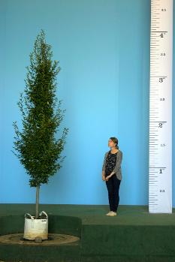
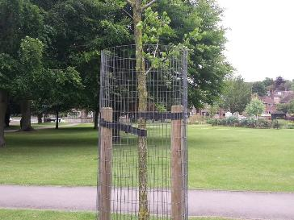
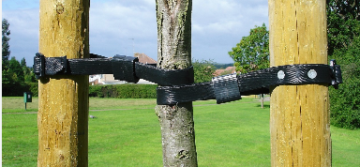
Stock recommendations
Selected standard form, containerised or container-grown trees are recommended for urban planting locations such as these.
Stock will have a stem girth of 12-14 cm at 1m above ground level. This size seems to offer a good balance between resistance to transplant chock and immediate presence in the landscape. They are easy to handle, usually supplied in a 45-50L container.
Standard form trees will have a clear stem of 175-200m, which is sufficient to install a 1.5m weldmesh guard ( if required to install ) without damaging lateral branches.
This reduces vandalism and the need for early-years pruning.
Illustration of 10-12 select standard trees, courtesy of Barcham Trees

Slide 12
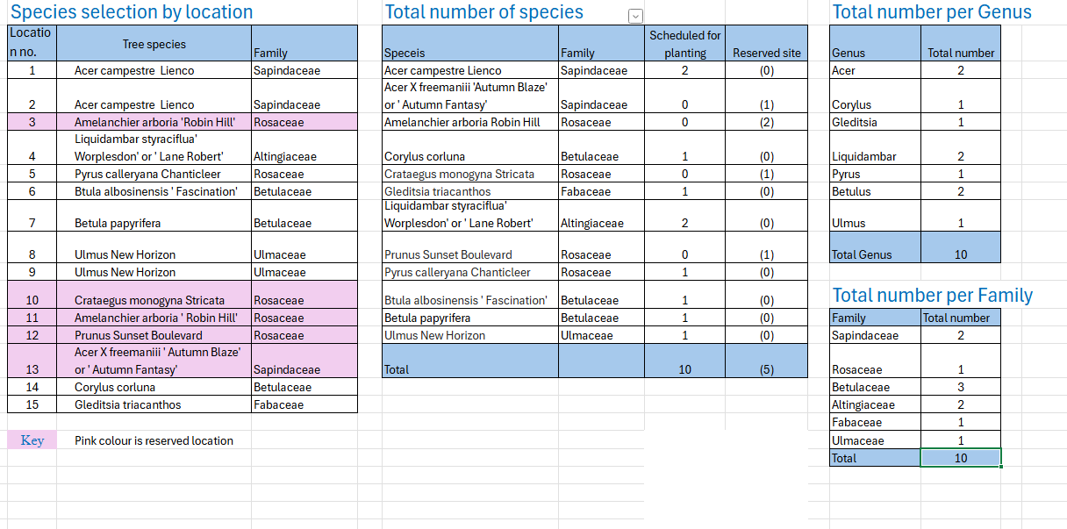
Species selection by location
3
1
1
1
Acer X Freemanii ‘Autumn Blaze’
Sapindaceae
3
1
Trees to be planted in first available planting season following approval of the Tree Planting Scheme
Note: Location number and tree species highlighted in pink colour are reserved trees.

Slide 13
Planting methodology
Methodology suitable for 6-18 to 20-25 standard root-balled, containerised or container-grown.
Service searches have already been done by HCC. The attached utility maps indicate the location of utilities
If unidentified services are found within the vicinity of the proposed tree during the tree planting works, tree planting will be carried out to the reserved locations.
Tree planting guidelines
Tree pits will be prepared in accordance with RBC’s standard tree pit details
Trees are proposed to be planted into areas of soft landscape. The general treatment of areas around newly planted trees should allow for adequate infiltration of water and free gas exchange, reduction of water evaporation and the retention of an open soil structure to encourage root growth.
Trees are to be planted using a suitable above ground staking system, in line with RBC’s standard tree pit details.
Root barriers to be used where necessary when, within hard landscape (paths, walls etc). Root barriers are not to be used when planting in soft landscape areas and unaffected by buildings or hard landscape.
Tree pits include the use of watering bags for irrigation.
Trees will be planted with an area of wood chip application around the stem, to a radius of at least 500mm (Subject to the sufficient space availability. The amount of wood chip application will be adjusted when no sufficient space for wood chip application of 500mm) . This woodchip will inhibit weed or grass growth which might otherwise compete with young root growth by intercepting available water supply.
Trees will be planted with Heavy standard stock size of 12-14cm girth based on BS3936.
Trees of this size are usually too big for people to vandalise and have a much better chance of surviving (larger trees can suffer from shock and can take longer to establish).
Maintenance
In line with Biodiversity Net Gain policy, RBC will be required to maintain the trees for a period of 30 years. However, as with all landscape features, maintenance is required in perpetuity and any future maintenance beyond the 30 year period will be on-going through RBC’s landscape maintenance teams.
Regular maintenance of newly planted trees is of particular importance for at least three years during the critical post-planting period.
Maintenance operations would normally include weed control and watering as necessary, inspection and adjustment of support systems and monitoring of growth.
Formative pruning might also be required to achieve desired effects or to provide for access or clearance.
Care should also be taken to avoid the risk of damage to the stems of young trees from future strumming or mowing operations.
Defects that become apparent during the maintenance period should be addressed by appropriate remedial works (including replacement planting where necessary) as advised by a competent person.

Slide 14
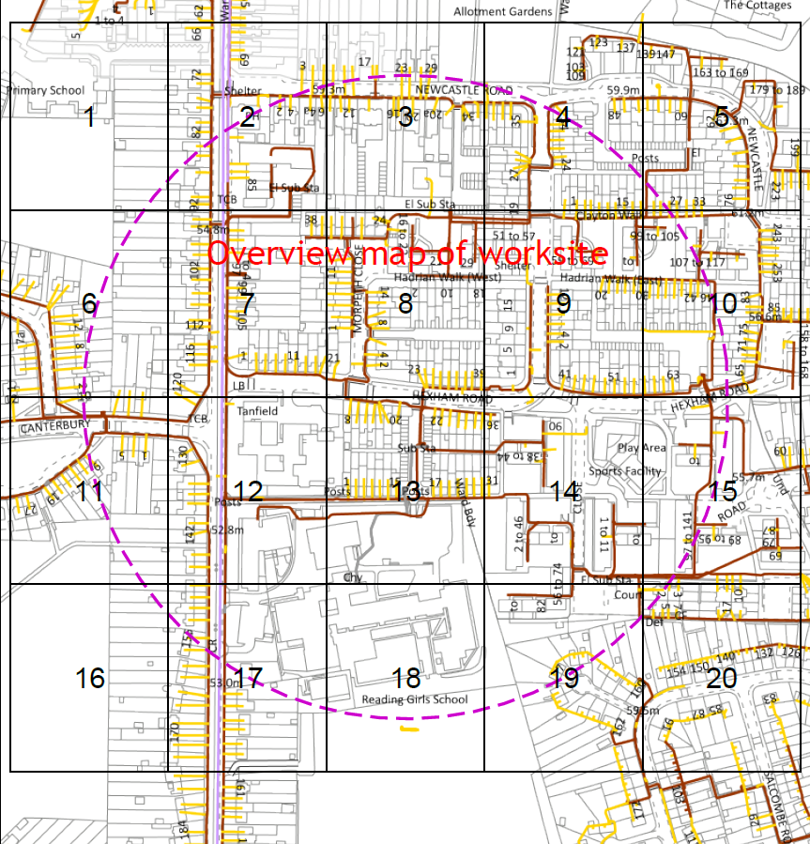
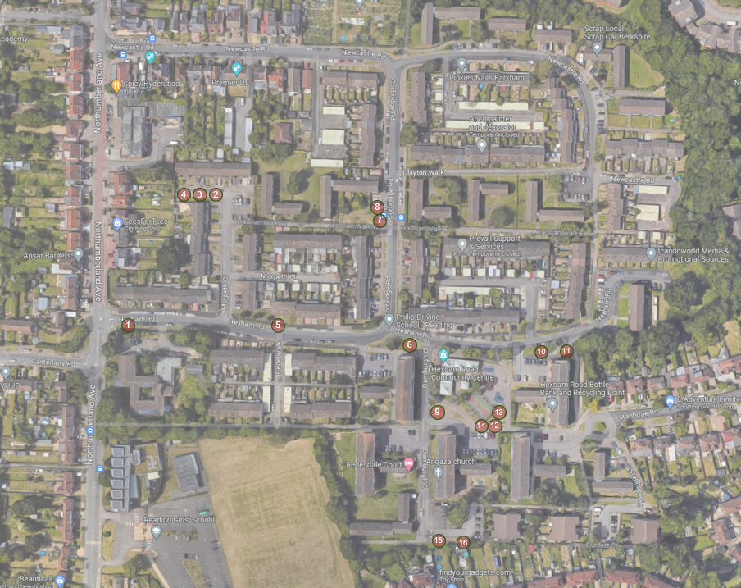

Slide 15


Slide 16
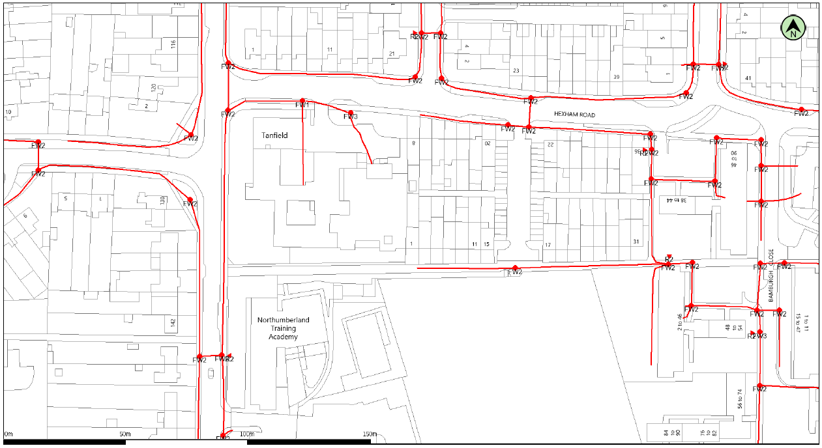

Slide 17
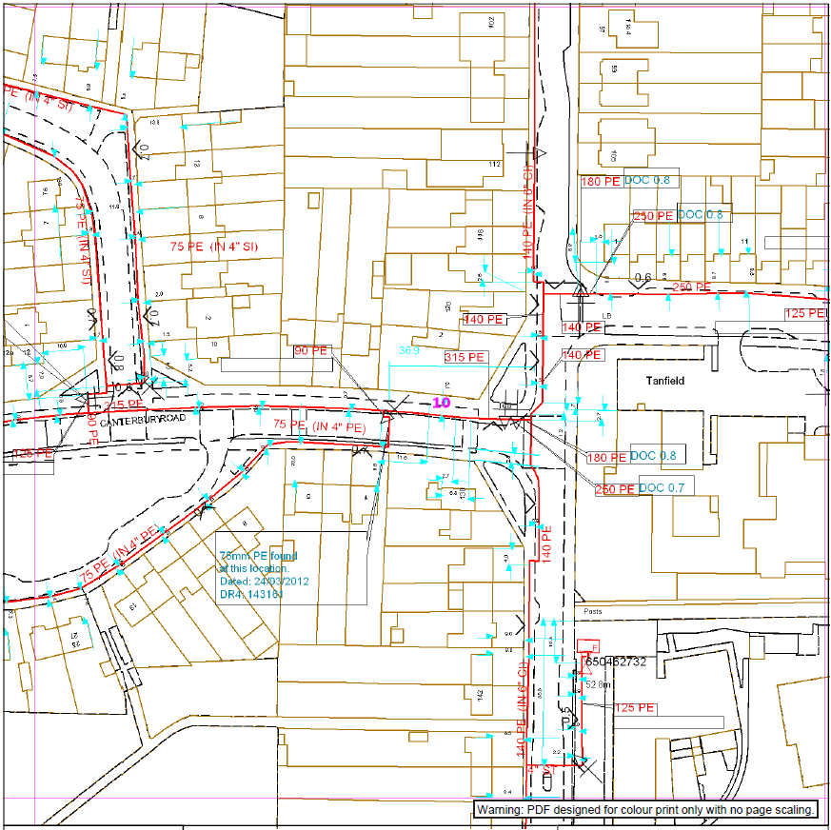
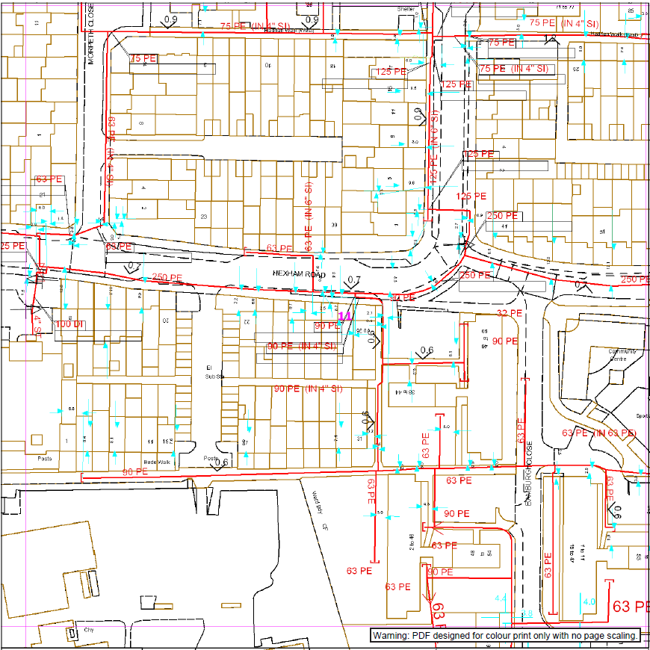

Slide 18
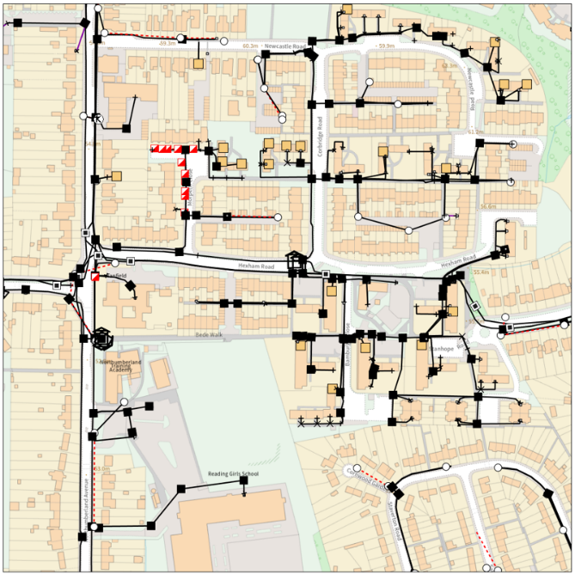

Slide 19
