Slide 1
51 Kendrick Road, Reading
Planning Applications
  181834 (approved);
  191751 (Approved)
    compared to 210686 (in progress)

Slide 2
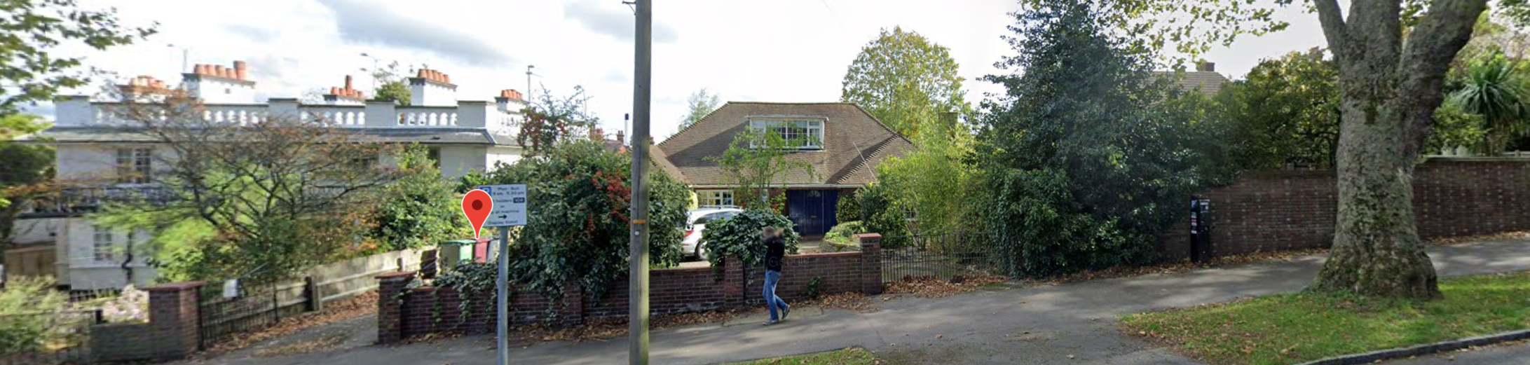
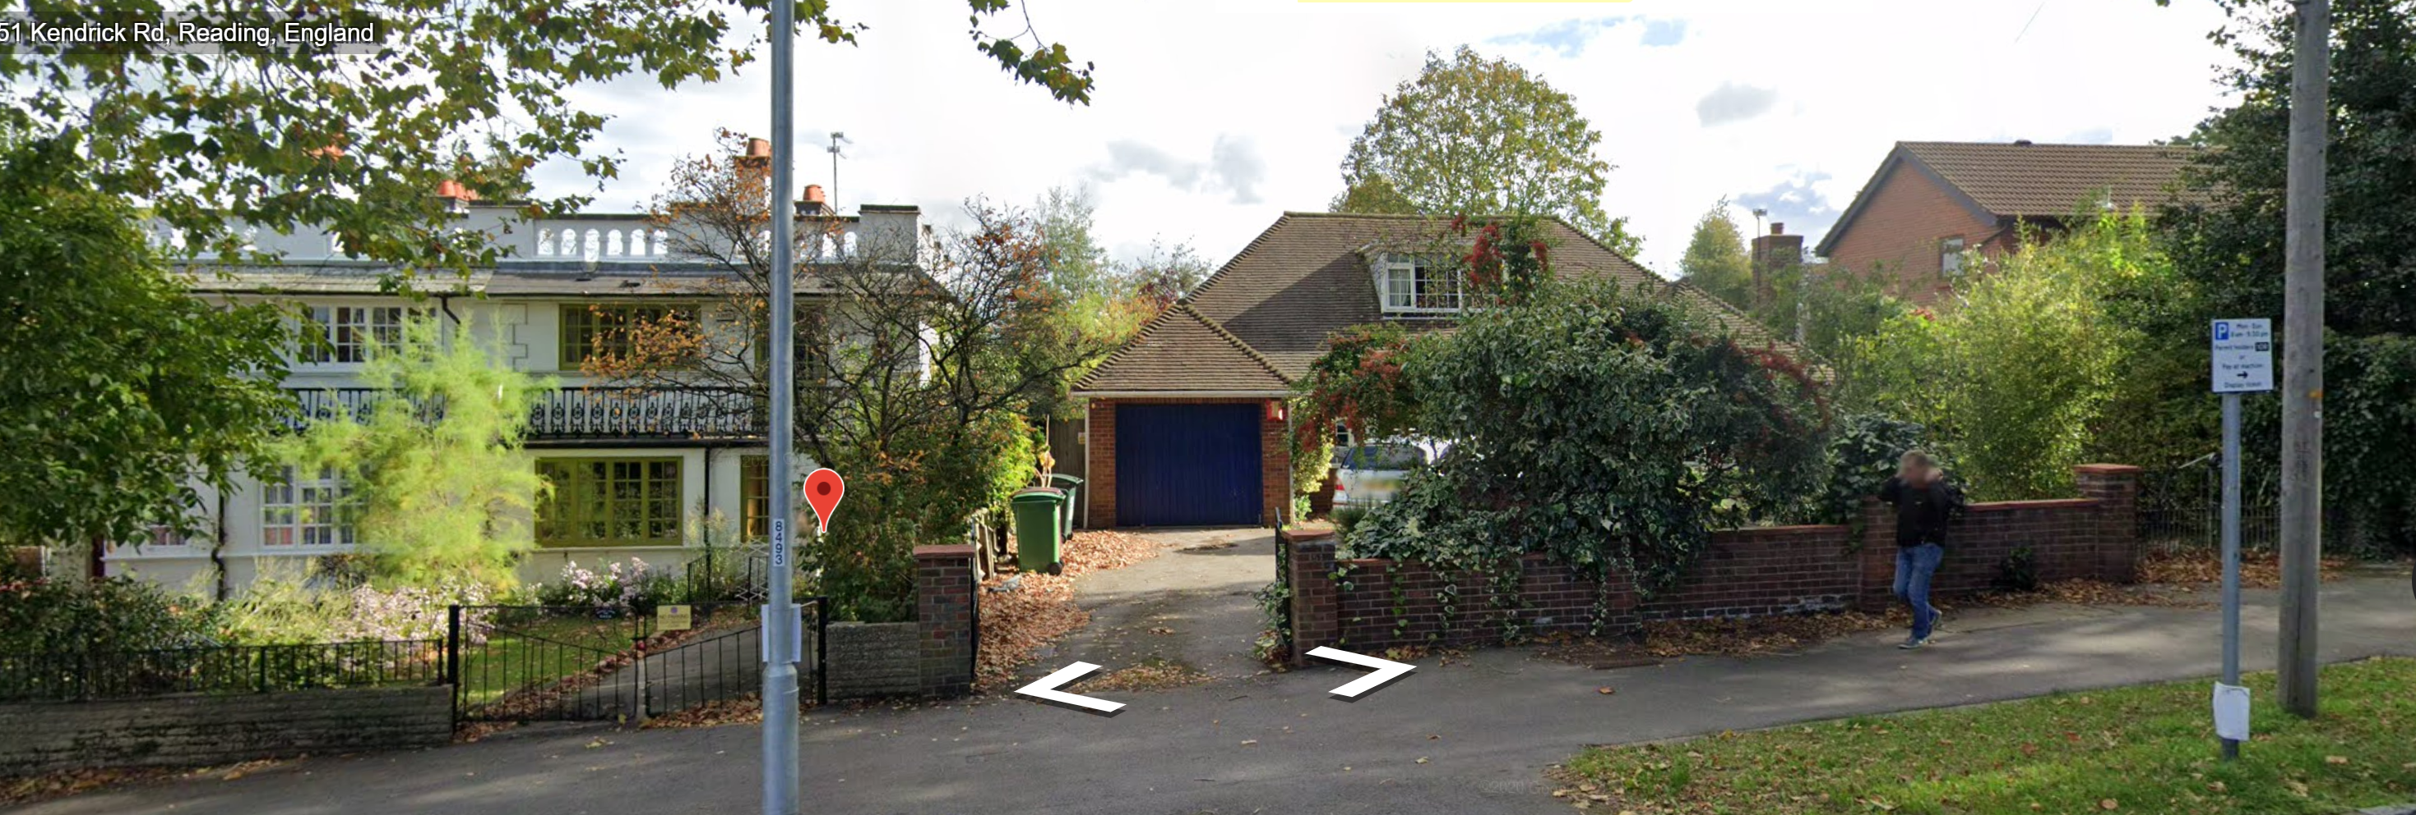
Original street scene (bungalow in the center)
Ground Floor outline of bungalow is not altered.

Slide 3
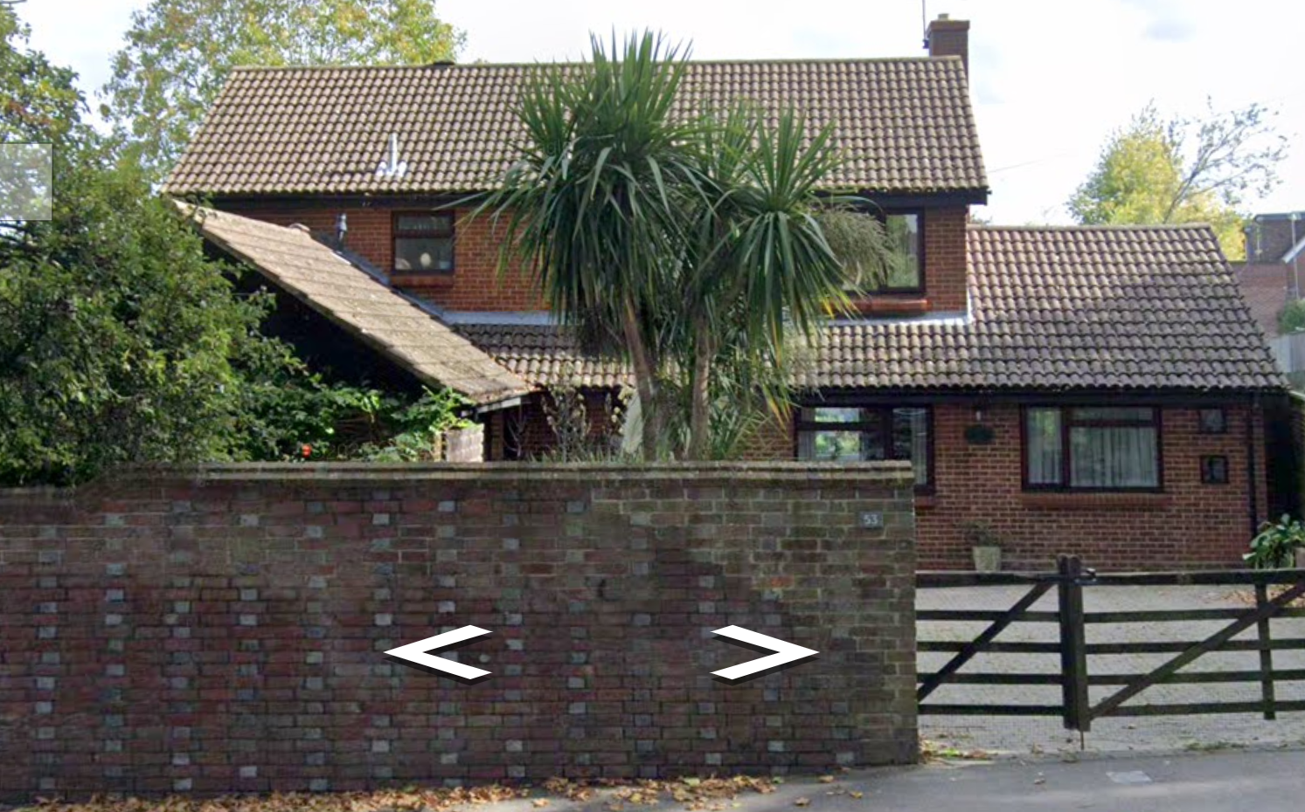
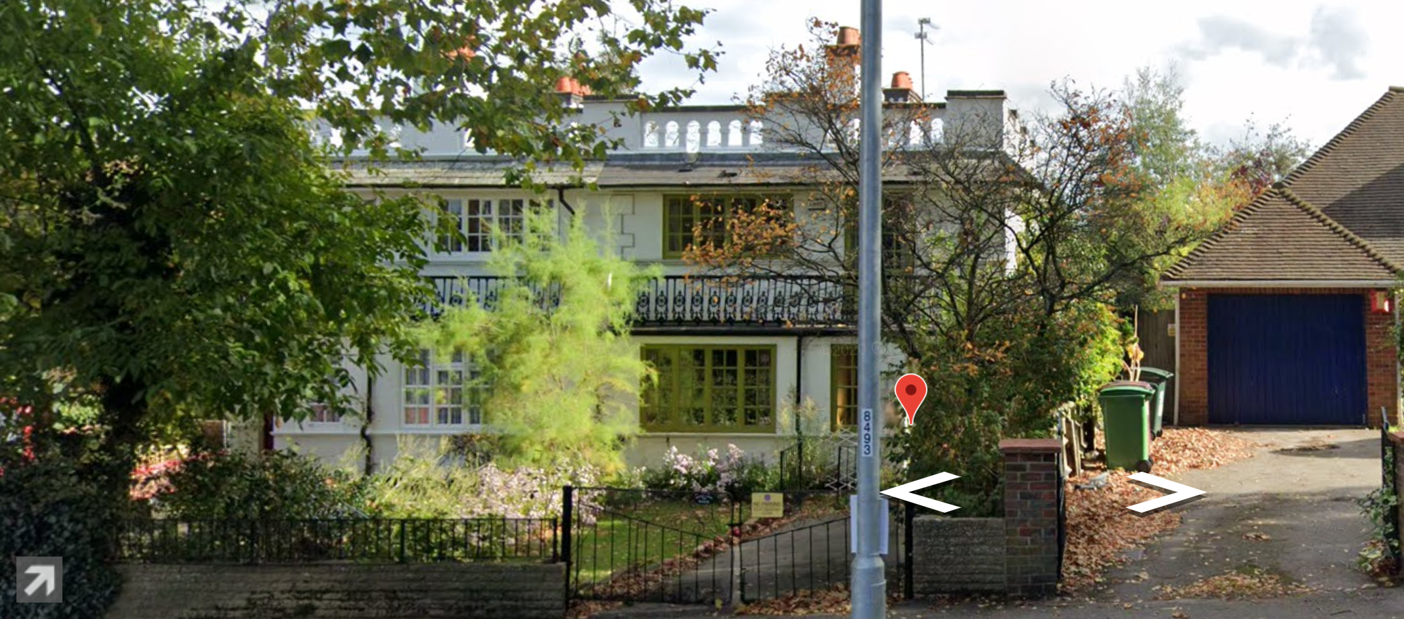
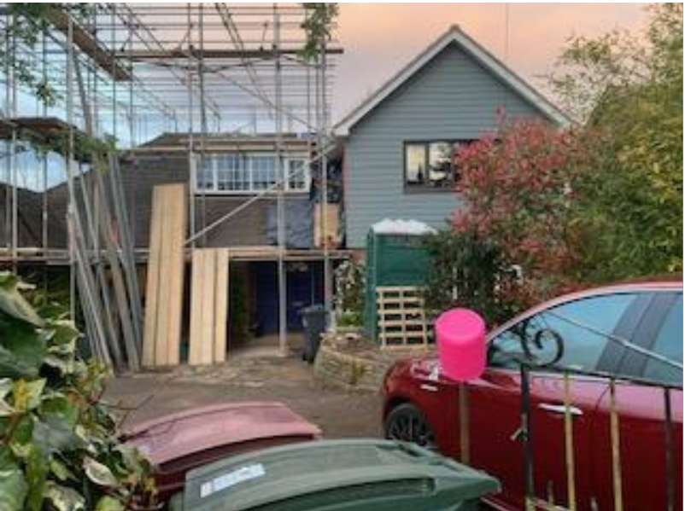

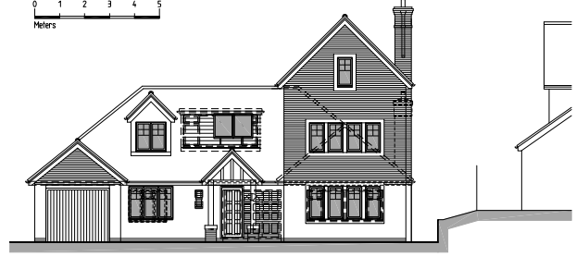
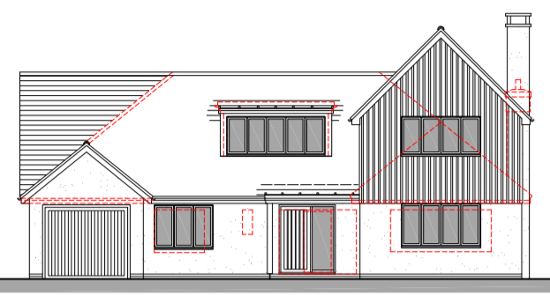
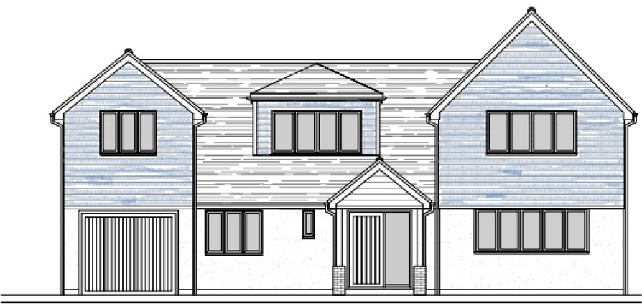

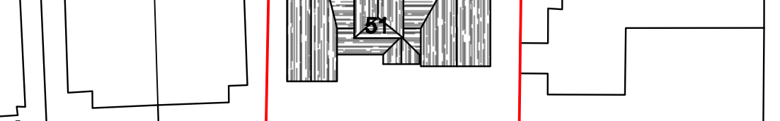
Approved Planning Application 181834 (build in progress) (No 49, 51 and 53)
Left-hand side hip-to-gable and hip-to-gable above garage, shown in scale drawing not yet built in photo above
47
49
47
49
53
Included to show the outline at the front. Note: there is approx. 3m between 49 (on left) and 51 (bungalow)

Slide 4
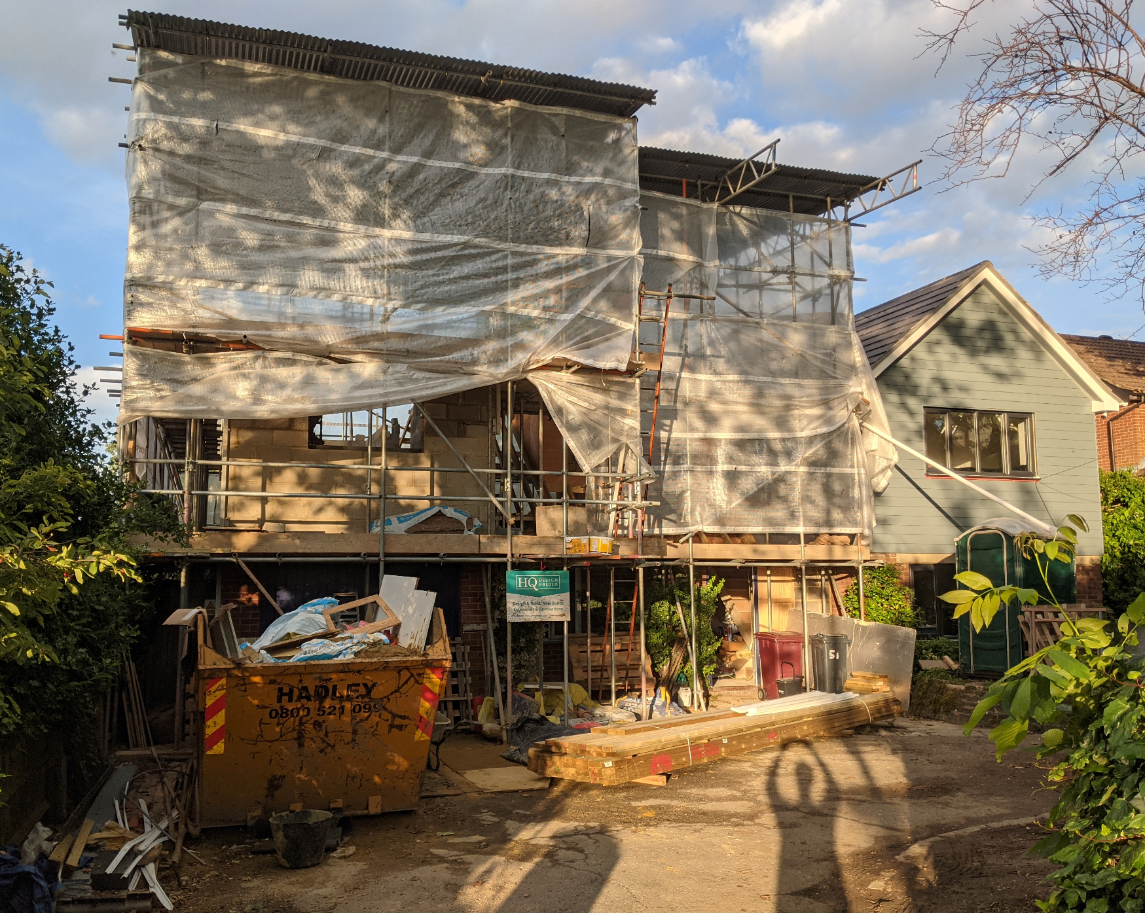
Awaiting Approval 210686
In this design, the dormer is now central and
has an attractive roof and smaller window. Additional story above garage.
Dormer at rear
47
49
Scale dra

Slide 5
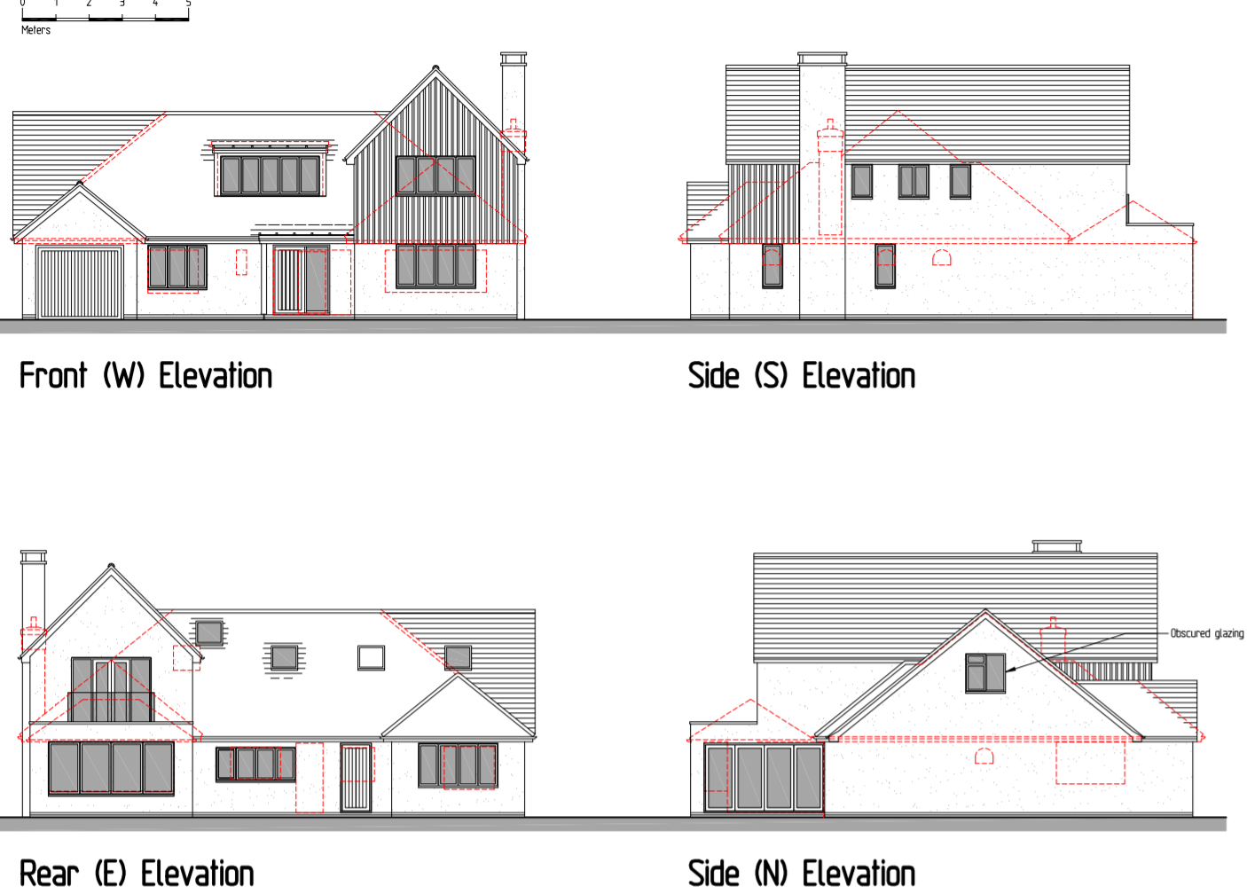
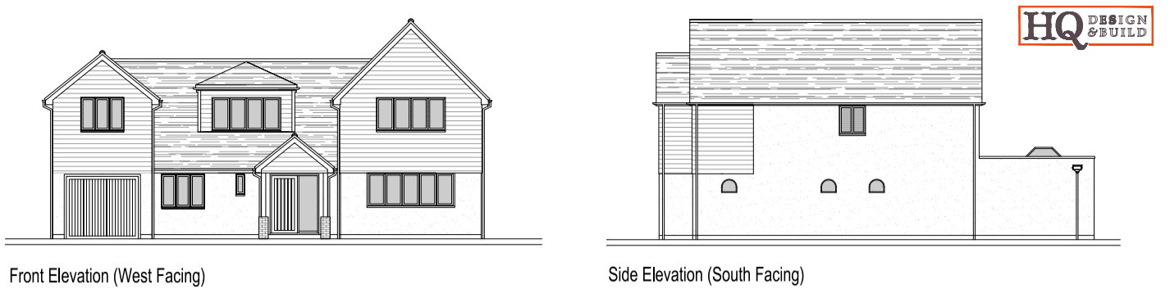
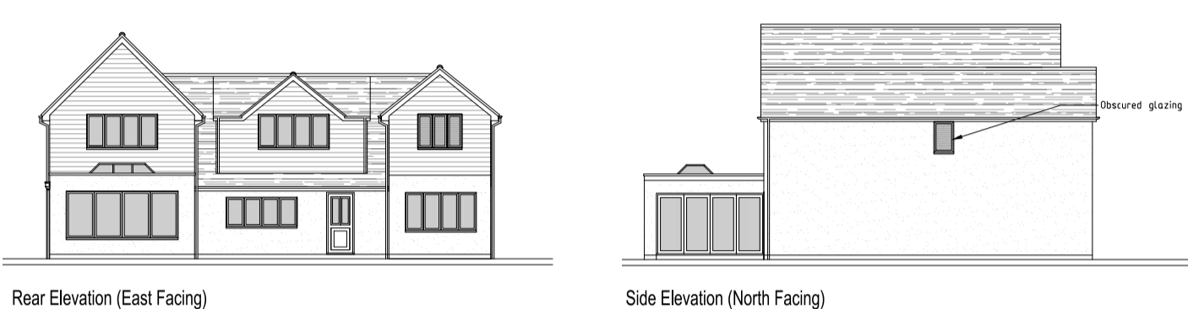
Approved (181834) vs In-Progress (210686) Planning Applications - elevations
Approved Planning Application 181834
In Progress Planning Application 210686

Slide 6
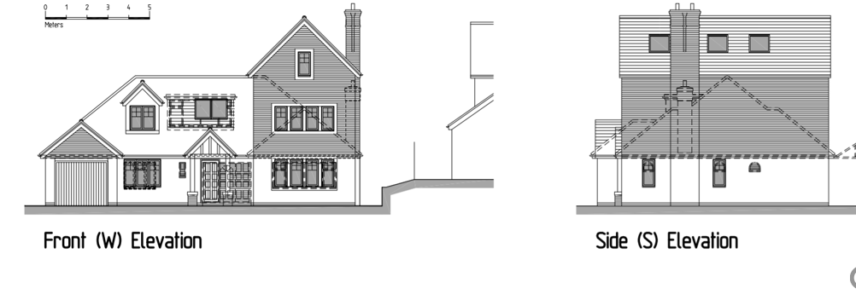
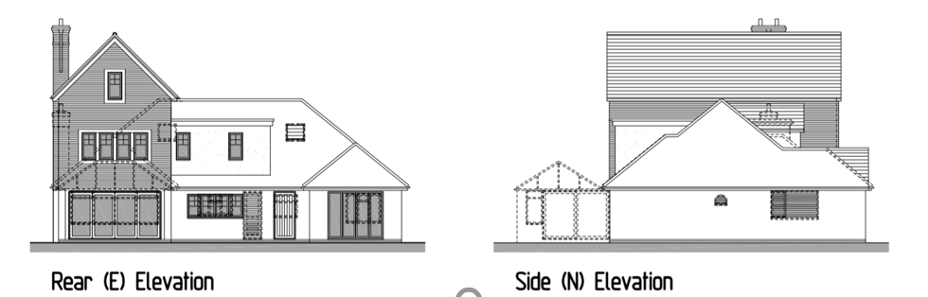
Approved (191751) vs In-Progress Planning (210686) Applications - elevations
Note: The new plan has an improved looking, centralised back dormer
Approved Planning Application 191751
In Progress Planning Application 210686

Slide 7
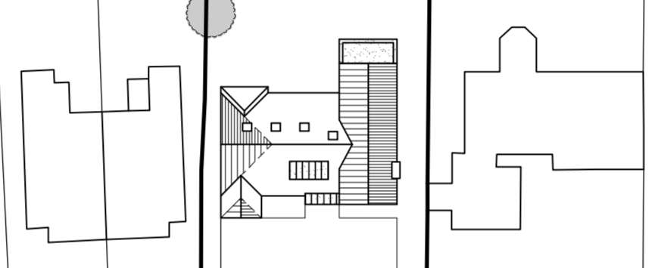
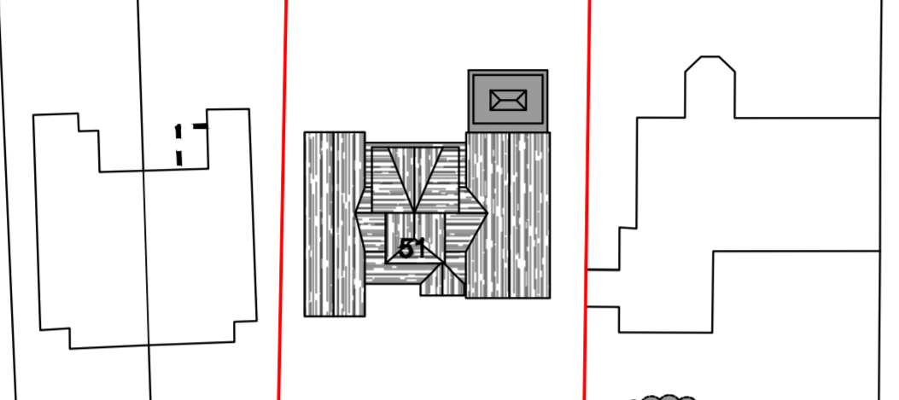
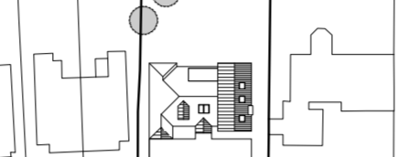
Approved vs In-Progress Planning Applications (site plan)
Approved Planning Application 181834
In Progress Planning Application 210686
Approved Planning Application 191751

Slide 8
Notes
No 49 elevation facing No 51 has obfuscated glass stair and bathroom windows and a kitchen window.
On the new plan (210686) , the maximum height of the wall facing No.51 is a bit less than the approved plan (181834)

