Slide 1

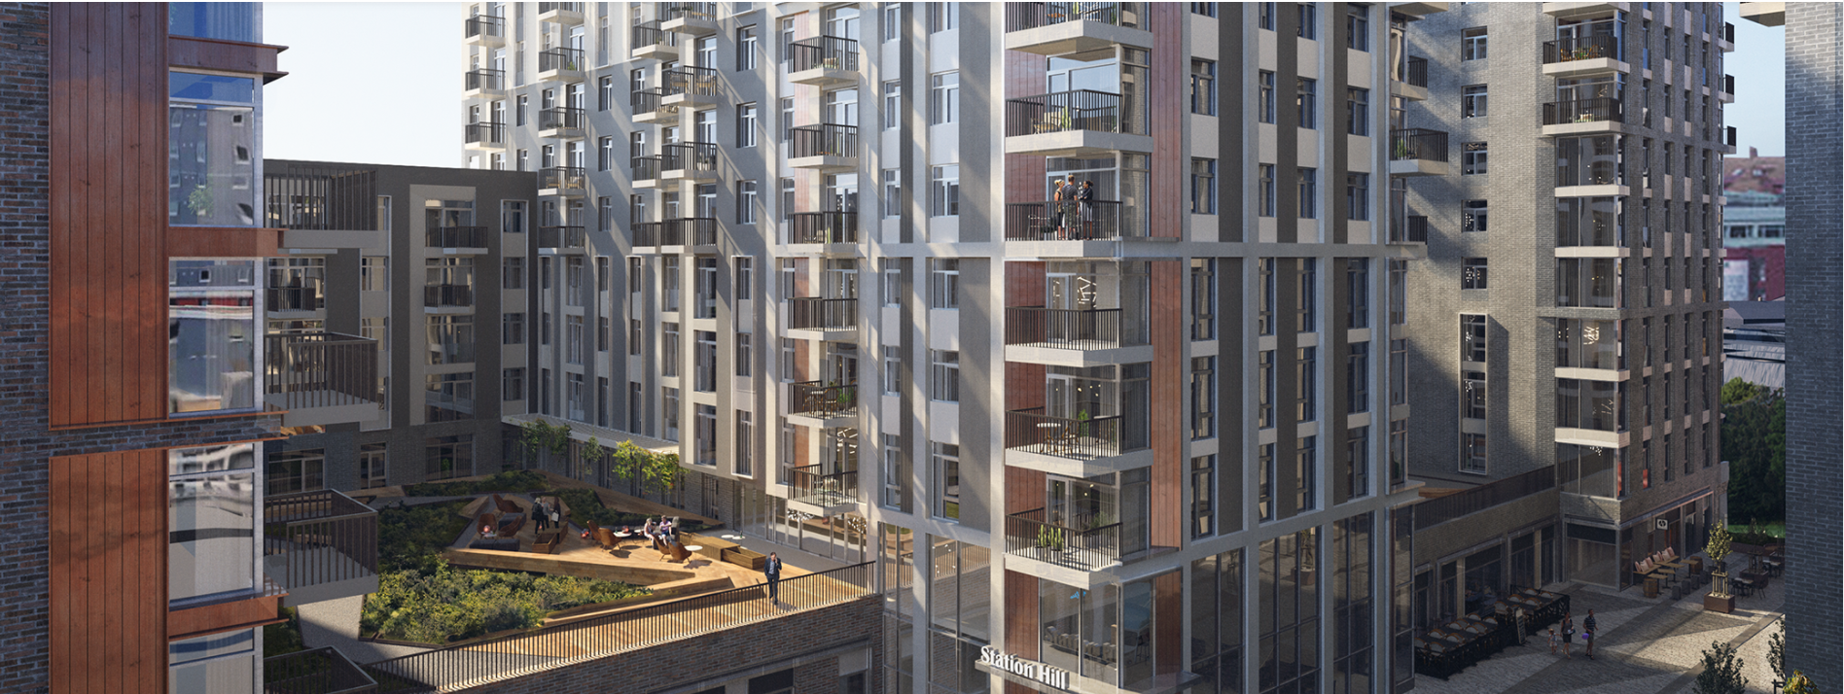
Station Hill, Reading
Envelope Materials

Slide 2
SHR – Material legend
 | PRODUCT | MDS REFERENCE
1 | Karma White Brick | Type 1
2 | Karma White Brick Slip | Type 2
3 | Pagus Grey Brick | Type 3
4 | Pagus Grey Brick Slip | Type 4
5 | Red Leicester Brick | Type 5
6 | Red Leicester Brick Slip | Type 6
7 | Aluminium Cladding in RAL 7035 (Light Grey) | Type 10
8 | Aluminium Cladding RAL 7031 (Blue Grey) | Type 13
9 | Aluminium Cladding in RAL 9010 (Pure White) | Type 11 & Type 12
10 | Aluminium Cladding in PIGMENTO® (Red) | Type 15
11 | Aluminium Cladding in RAL 7022 (Umbra Grey) | Type 18
12 | Windows & Cills in RAL 7006 (Beige Grey) & 7022 (Umbra Grey) | N/A
13 | Curtain Walling in RAL 7006 (Beige Grey) & 7022 (Umbra Grey) | N/A
14 | Metal Balustrade, Aluminium Balcony Decking and Balcony Soffits in RAL 7006 (Beige Grey) & 7022 (Umbra Grey) | N/A

Slide 3
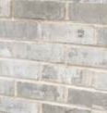
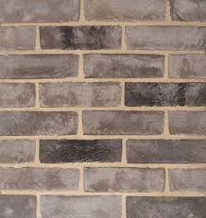
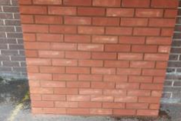

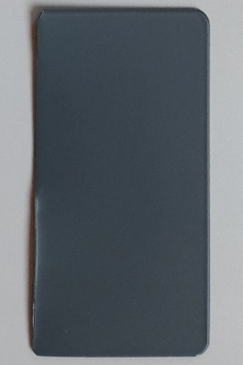
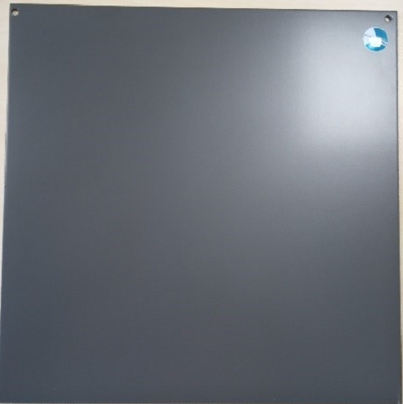
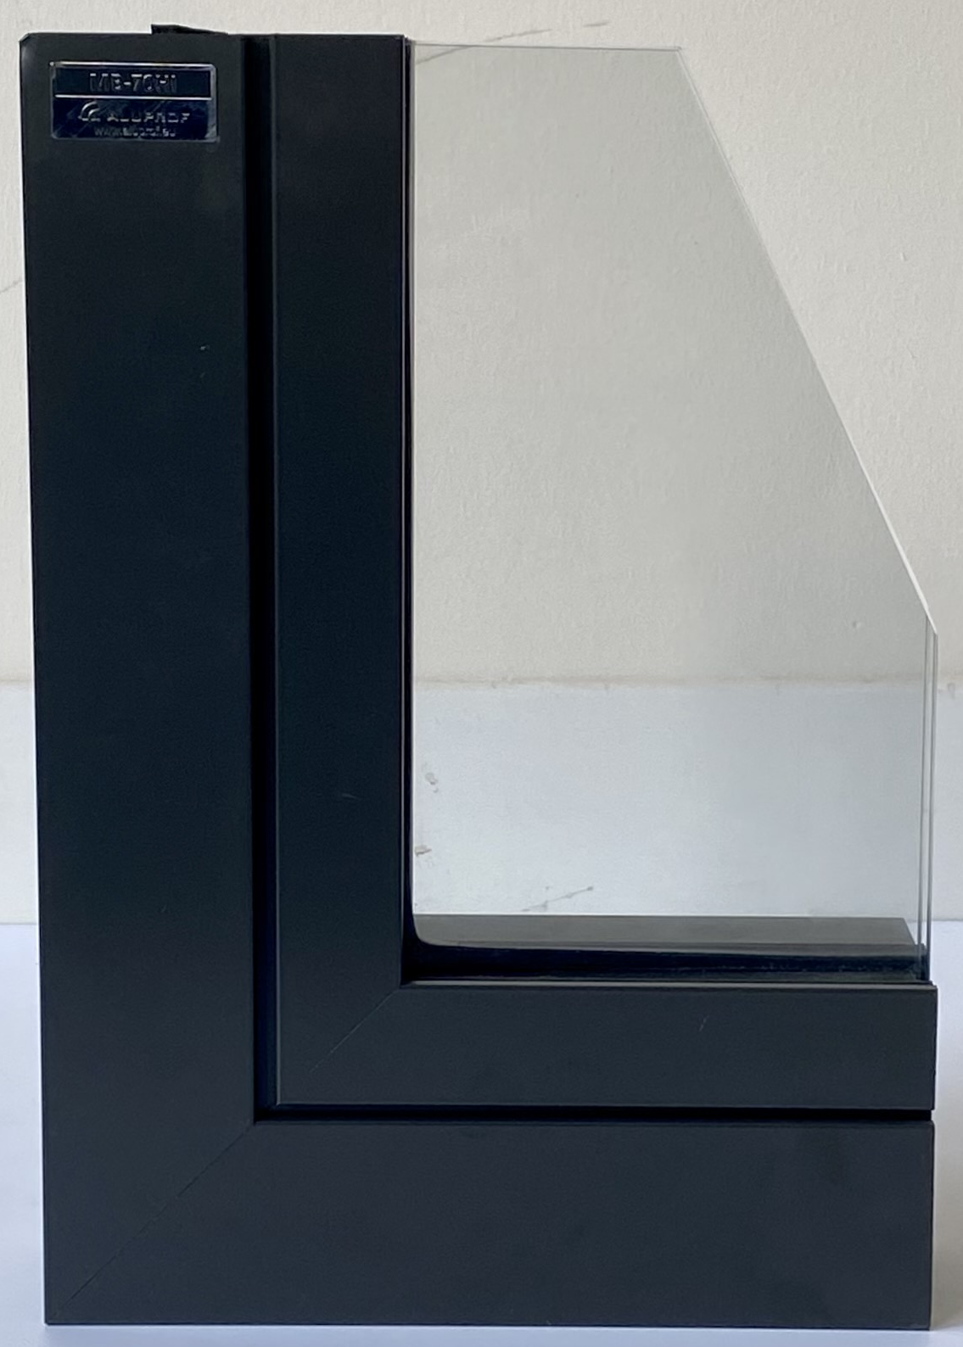
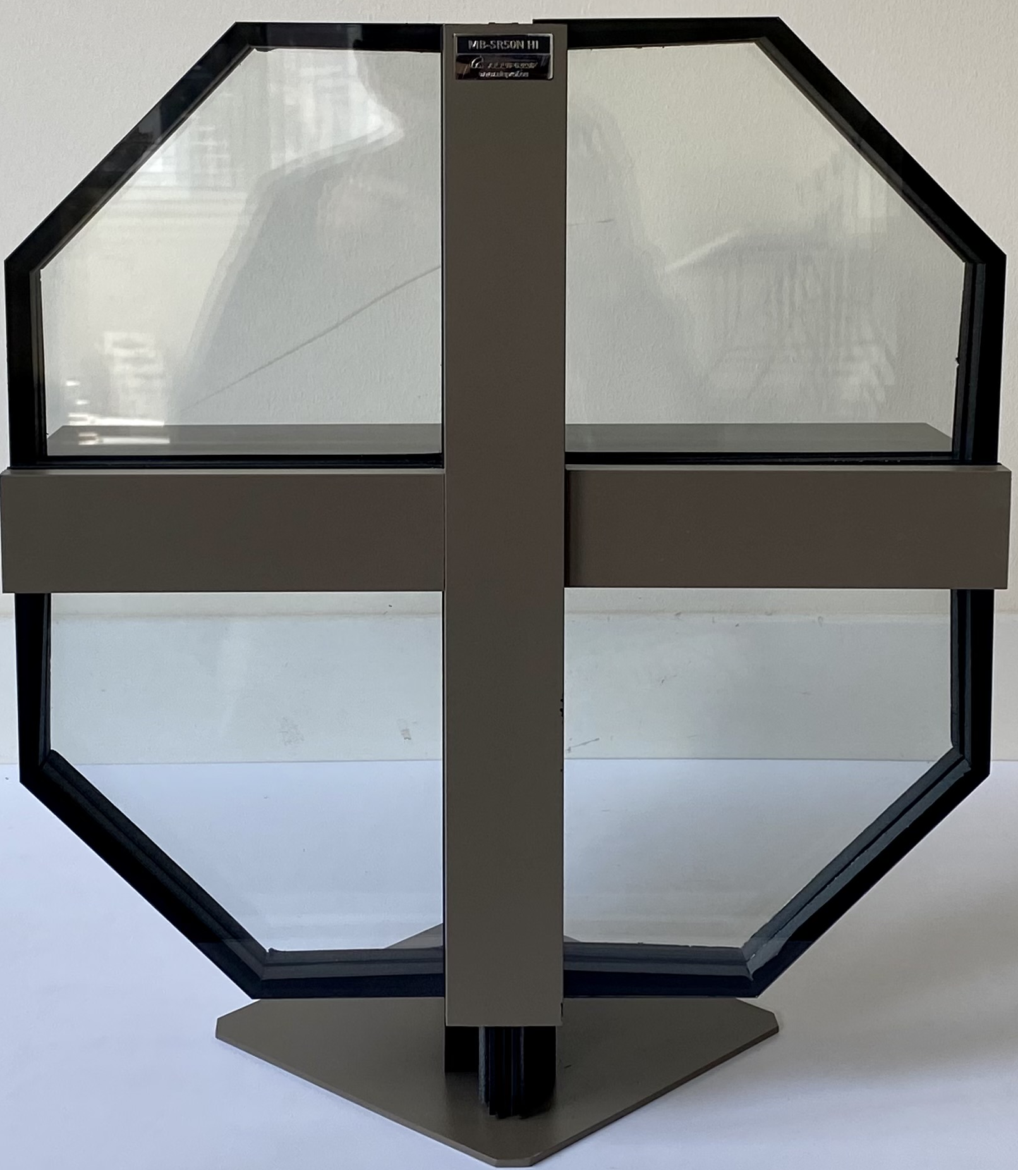
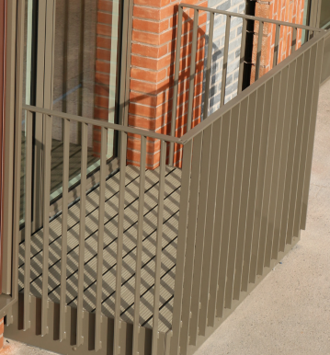
Shr – MATERIAL IMAGES
1 & 2
3 & 4
5 & 6
8
9
BLOCK E – WEST ELEVATIONS 1/3
7
11
12
13
14
10

Slide 4
BLOCK E – GENERAL KEY PLAN

Slide 5
BLOCK E – FRIARS WALK ELEVATIONS 1/2

Slide 6
BLOCK E – FRIARS WALK ELEVATIONS 2/2

Slide 7
BLOCK E – NORTH COURTYARD ELEVATIONS 1/3

Slide 8
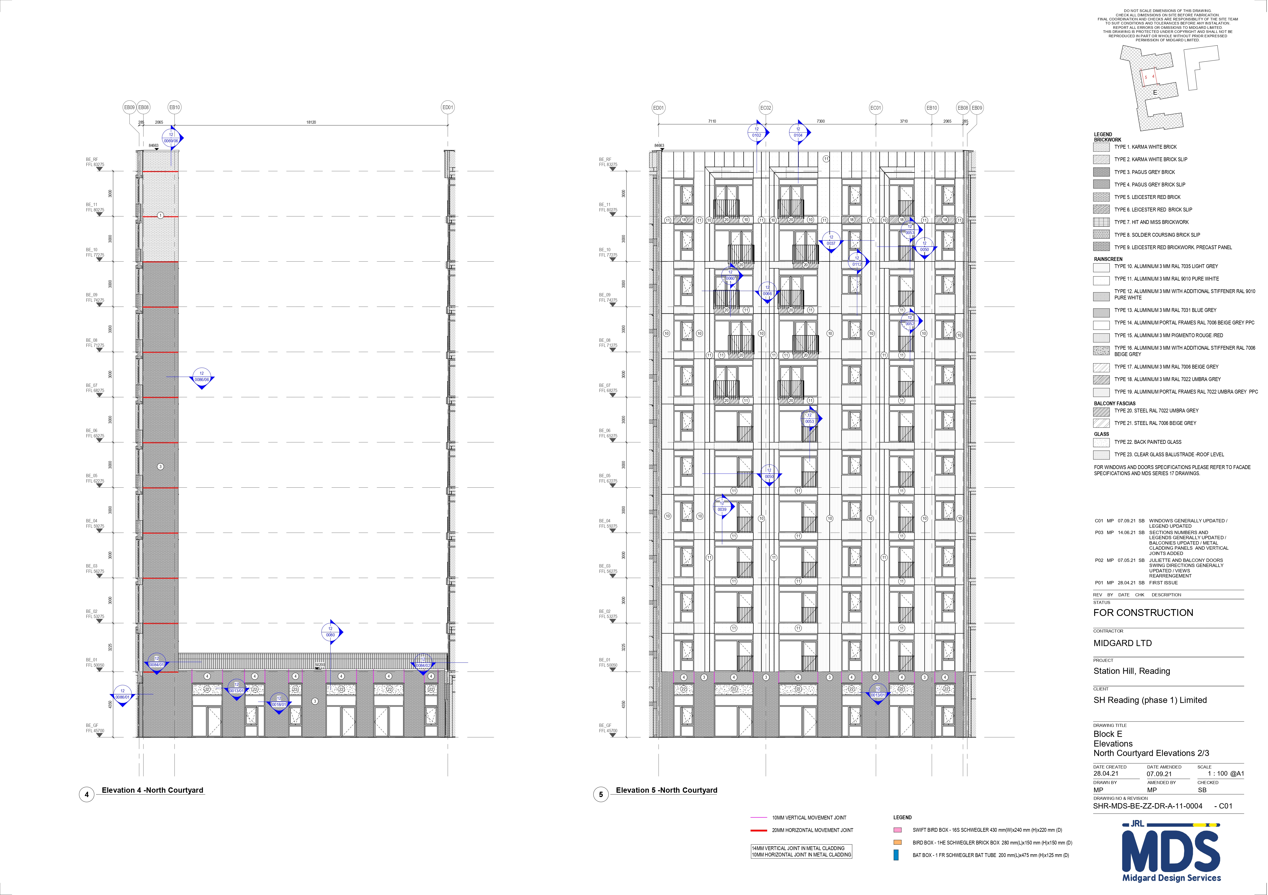
BLOCK E – NORTH COURTYARD ELEVATIONS 2/3

Slide 9
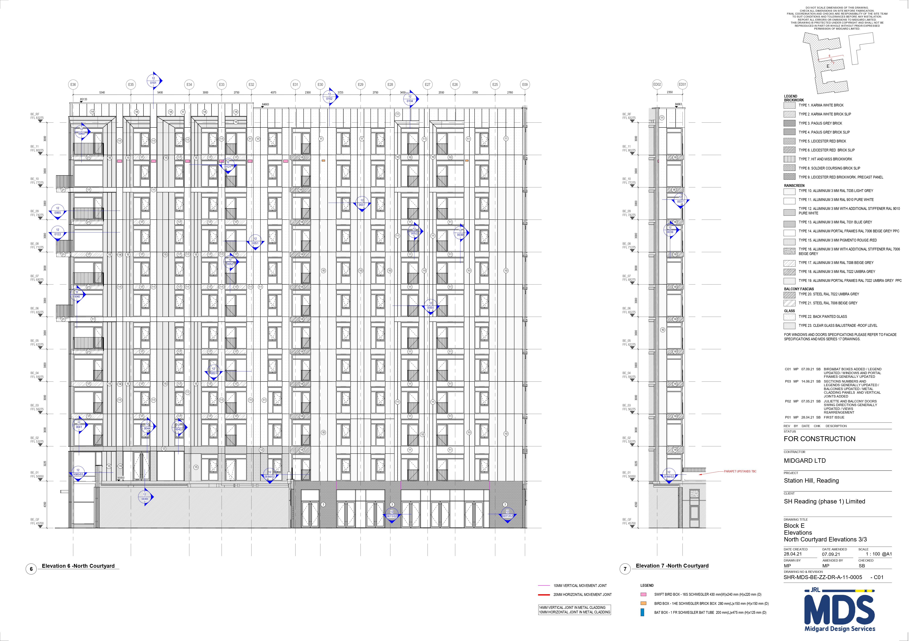
BLOCK E – NORTH COURTYARD ELEVATIONS 3/3

Slide 10
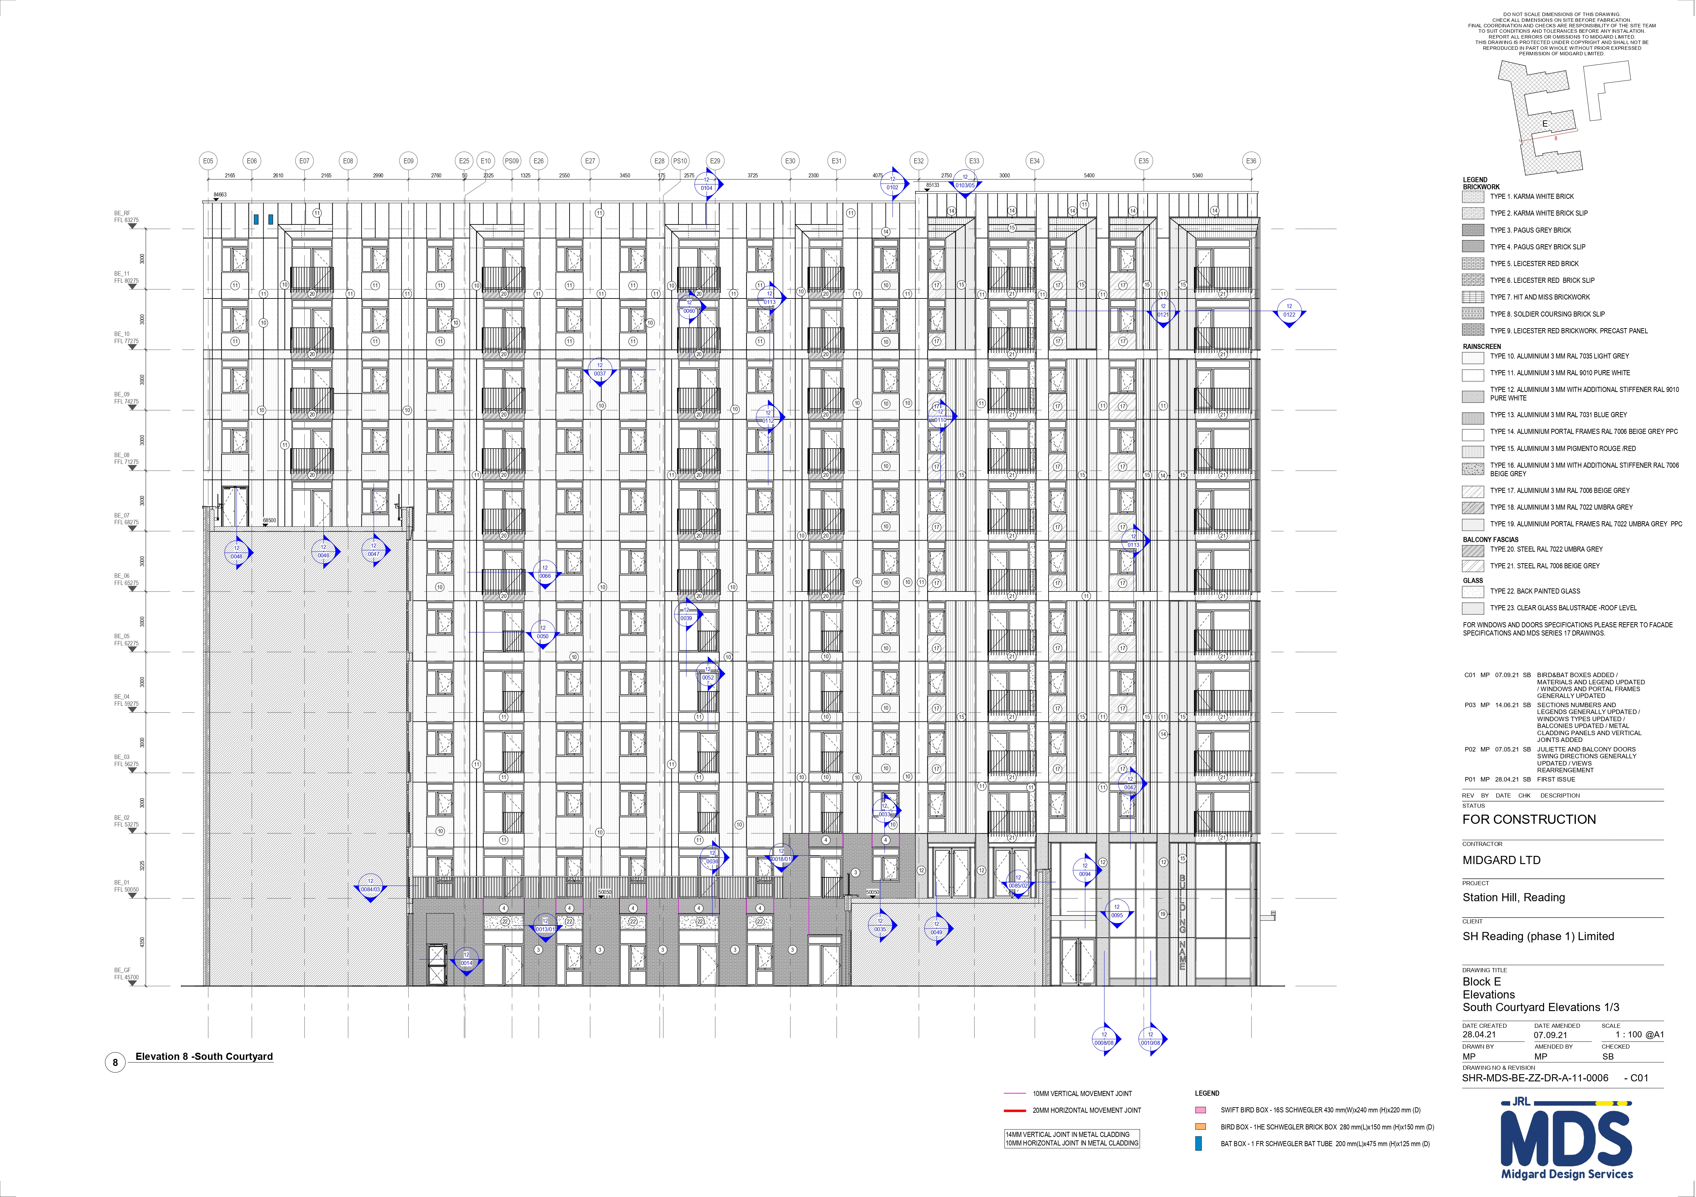
BLOCK E – SOUTH COURTYARD ELEVATIONS 1/3

Slide 11
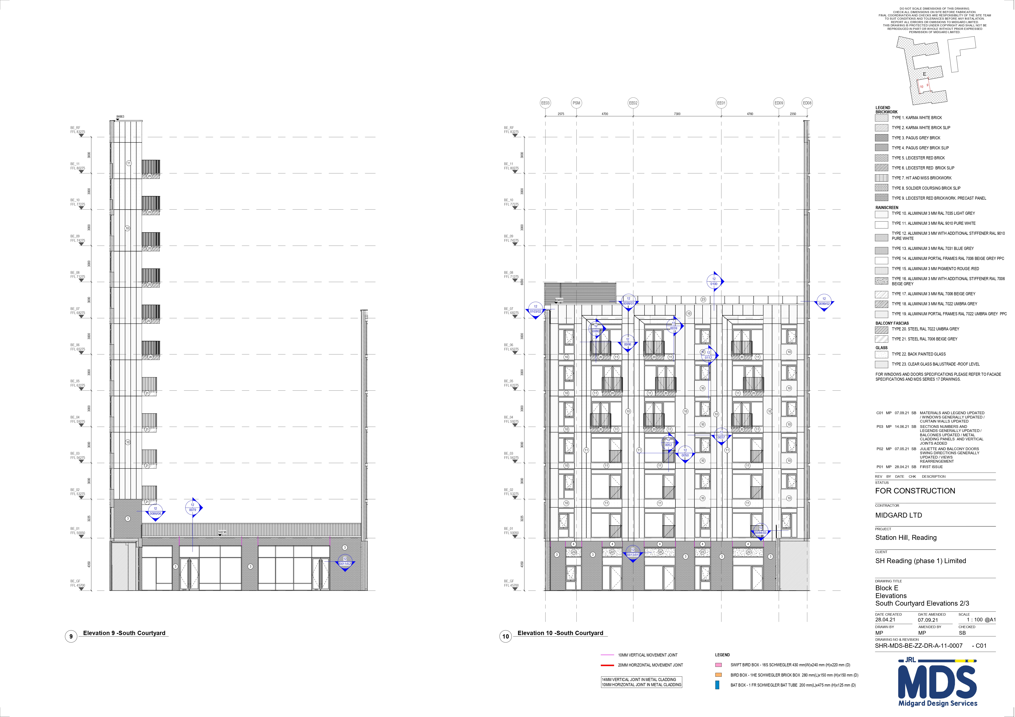
BLOCK E – SOUTH COURTYARD ELEVATIONS 2/3

Slide 12
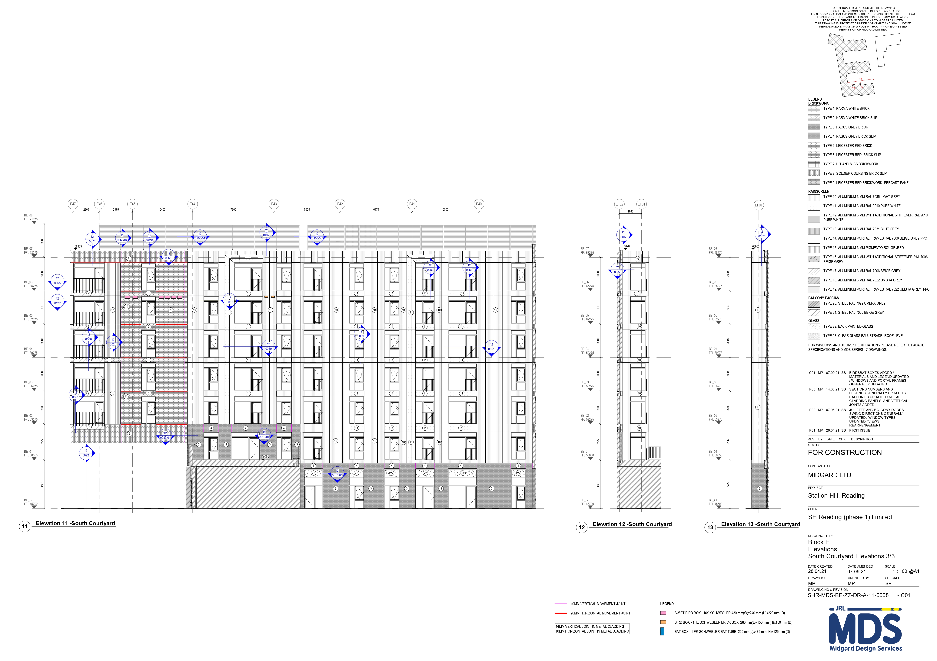
BLOCK E – SOUTH COURTYARD ELEVATIONS 3/3

Slide 13
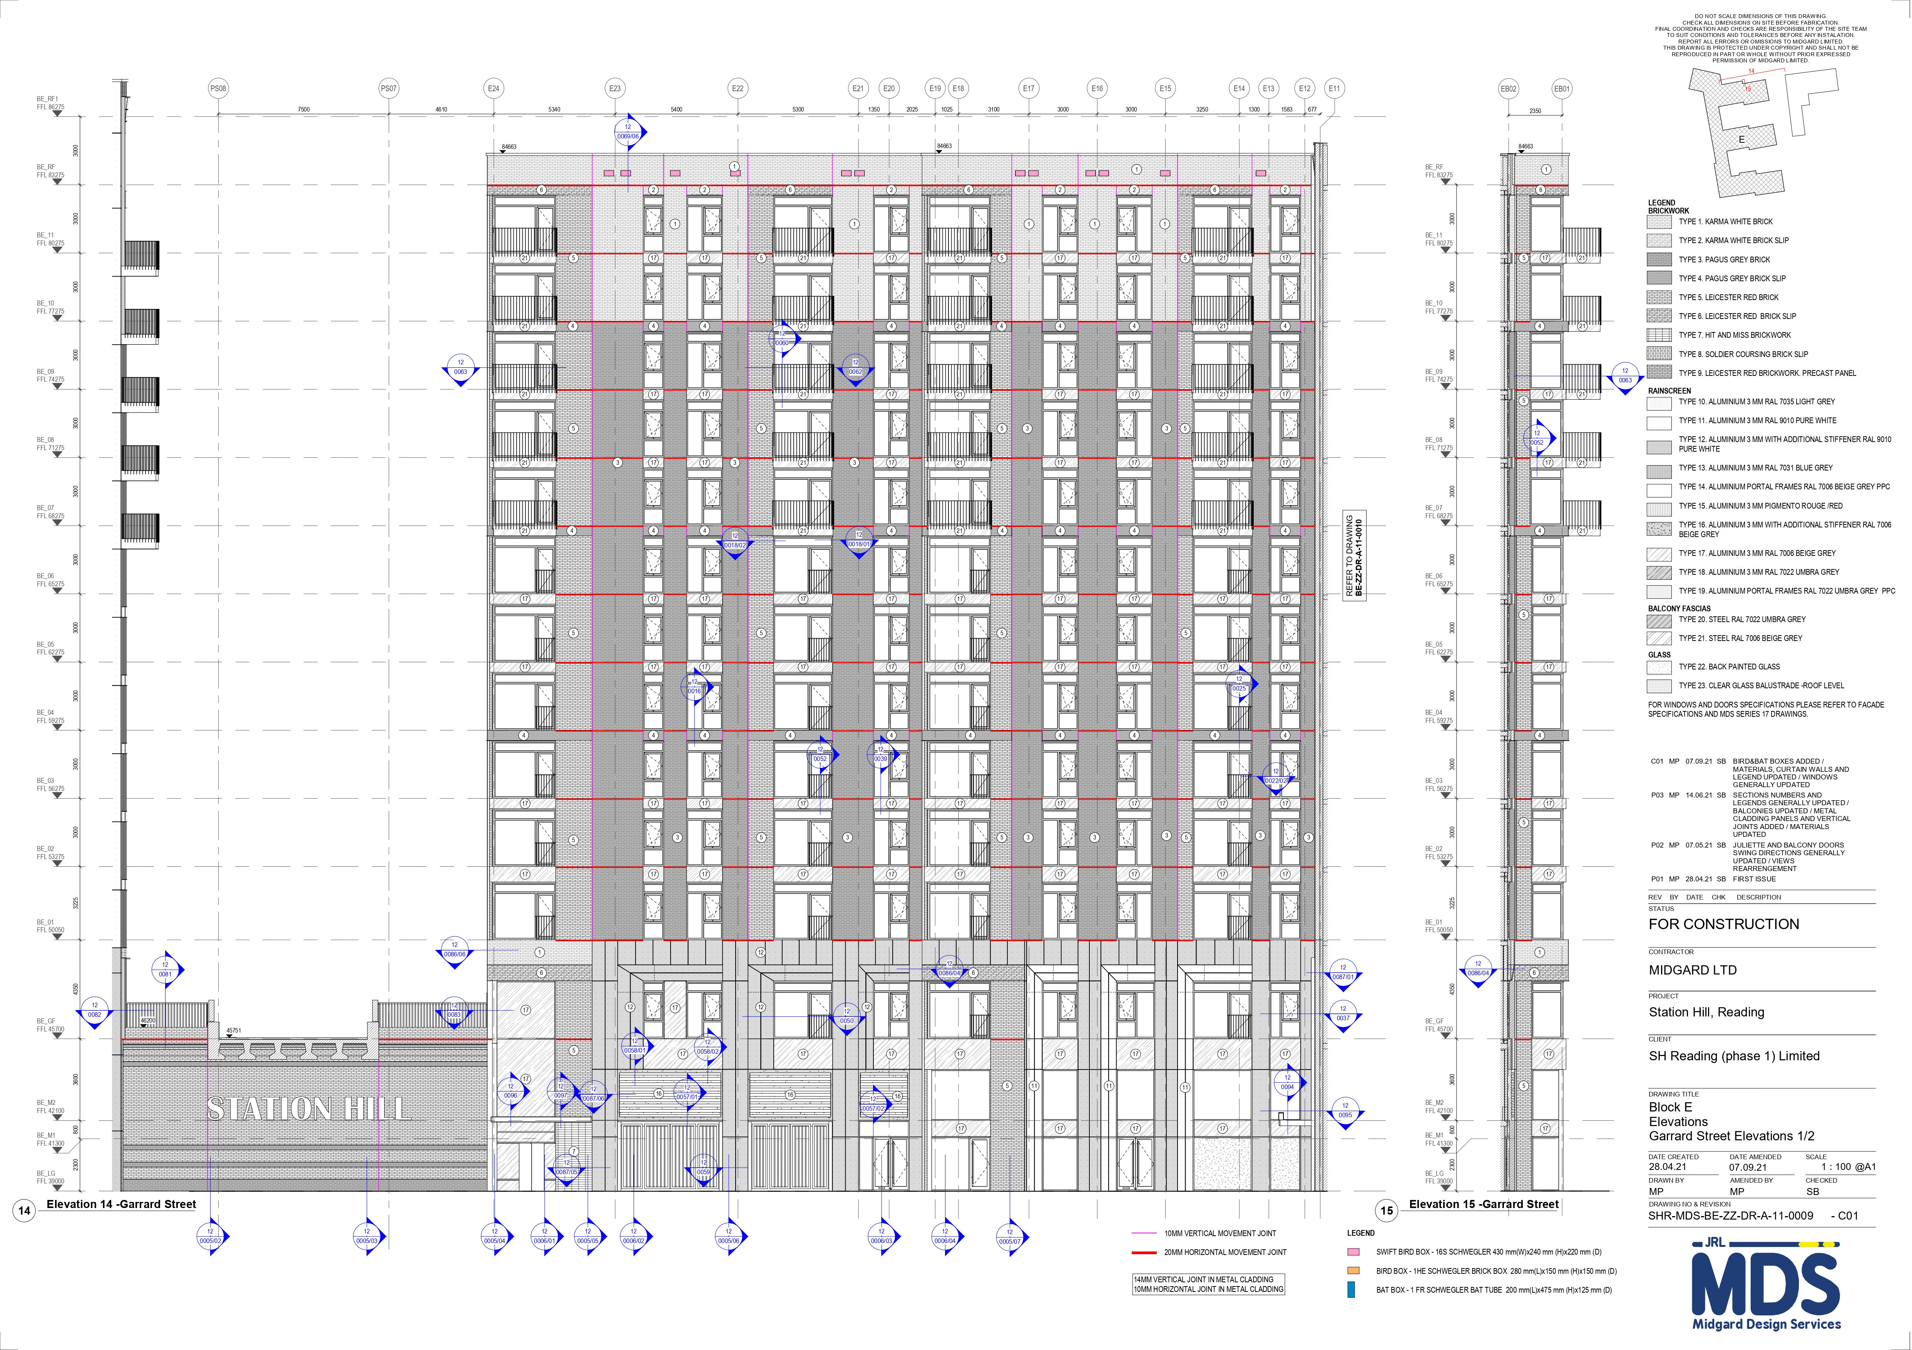
BLOCK E – GERRARD STREET ELEVATIONS 1/2

Slide 14
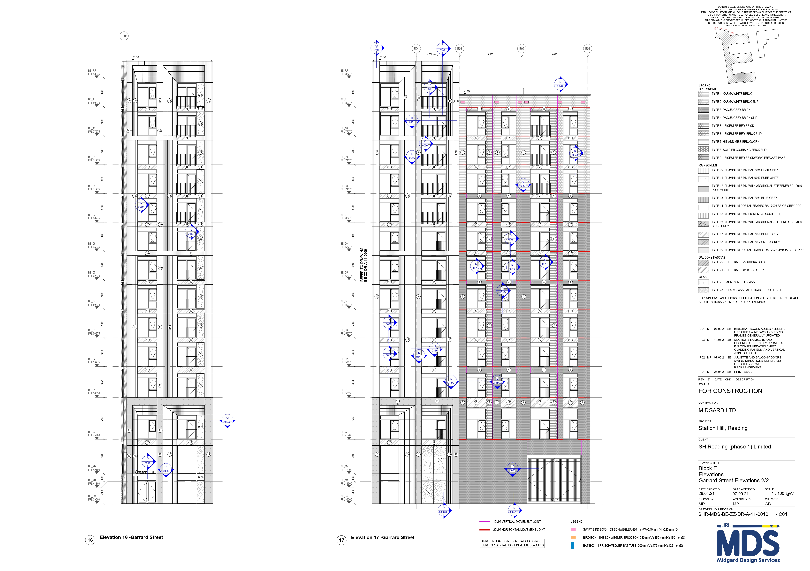
BLOCK E – GERRARD STREET ELEVATIONS 2/2

Slide 15
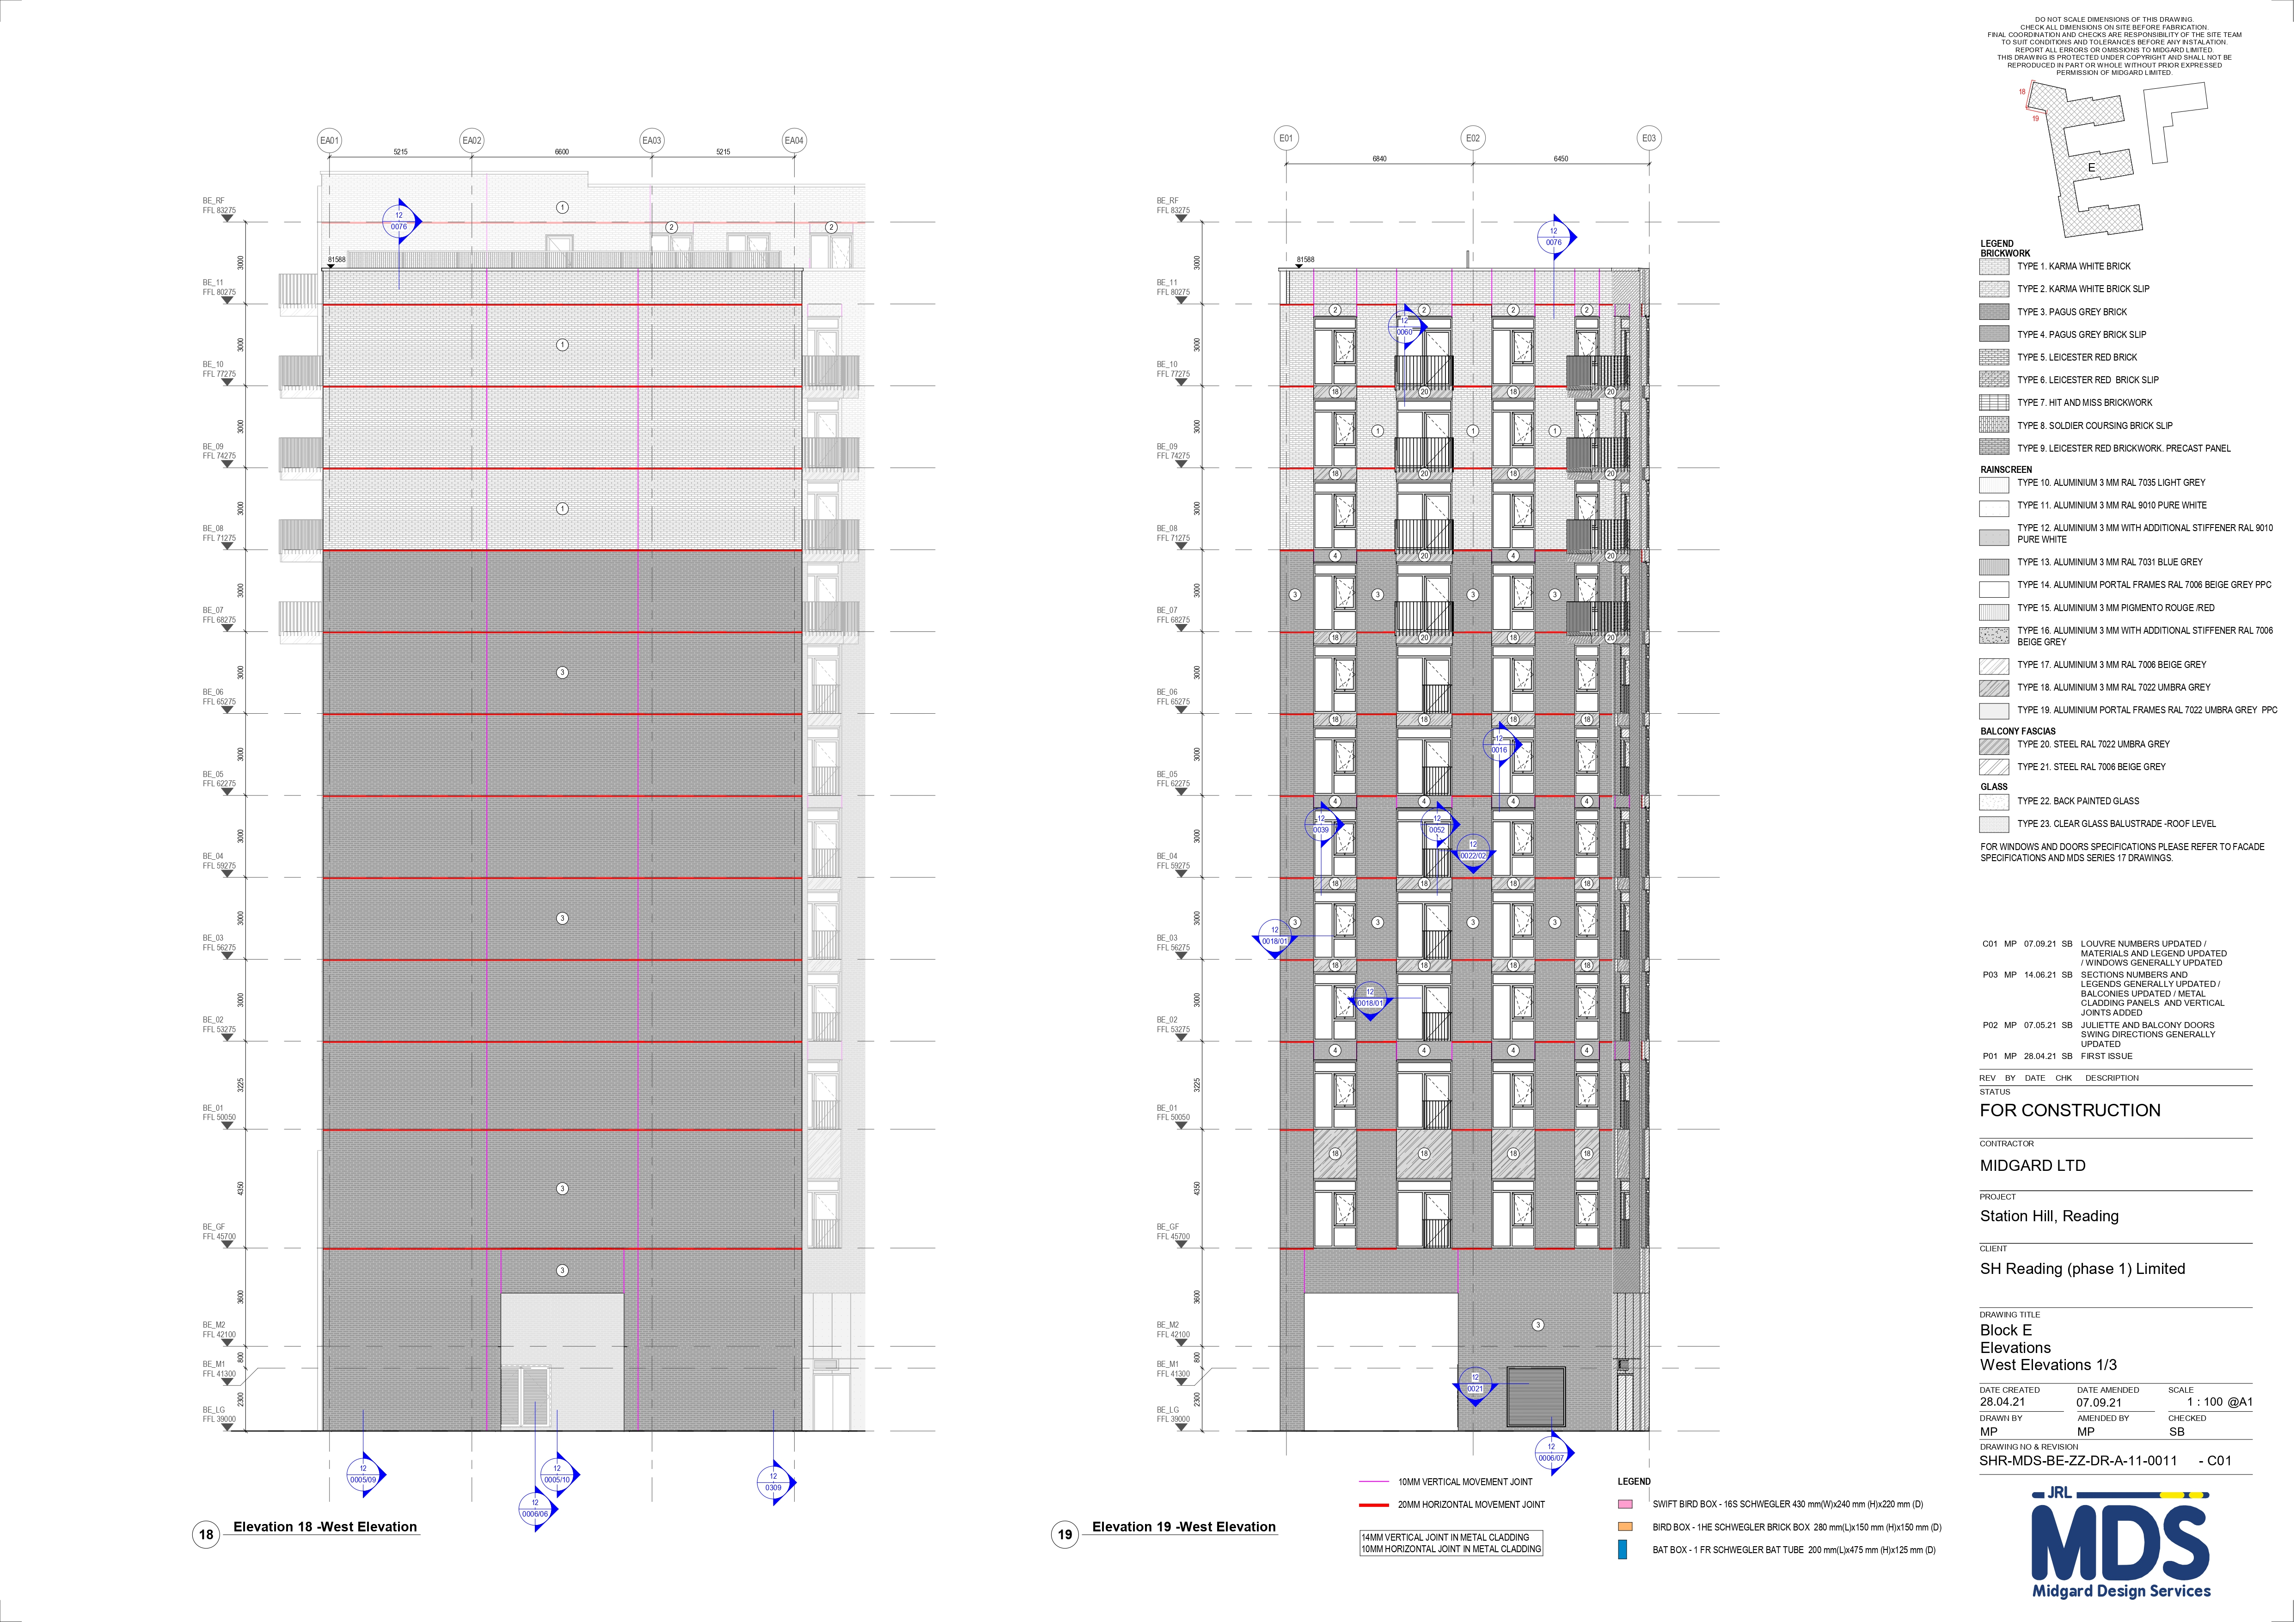
BLOCK E – WEST ELEVATIONS 1/3

Slide 16
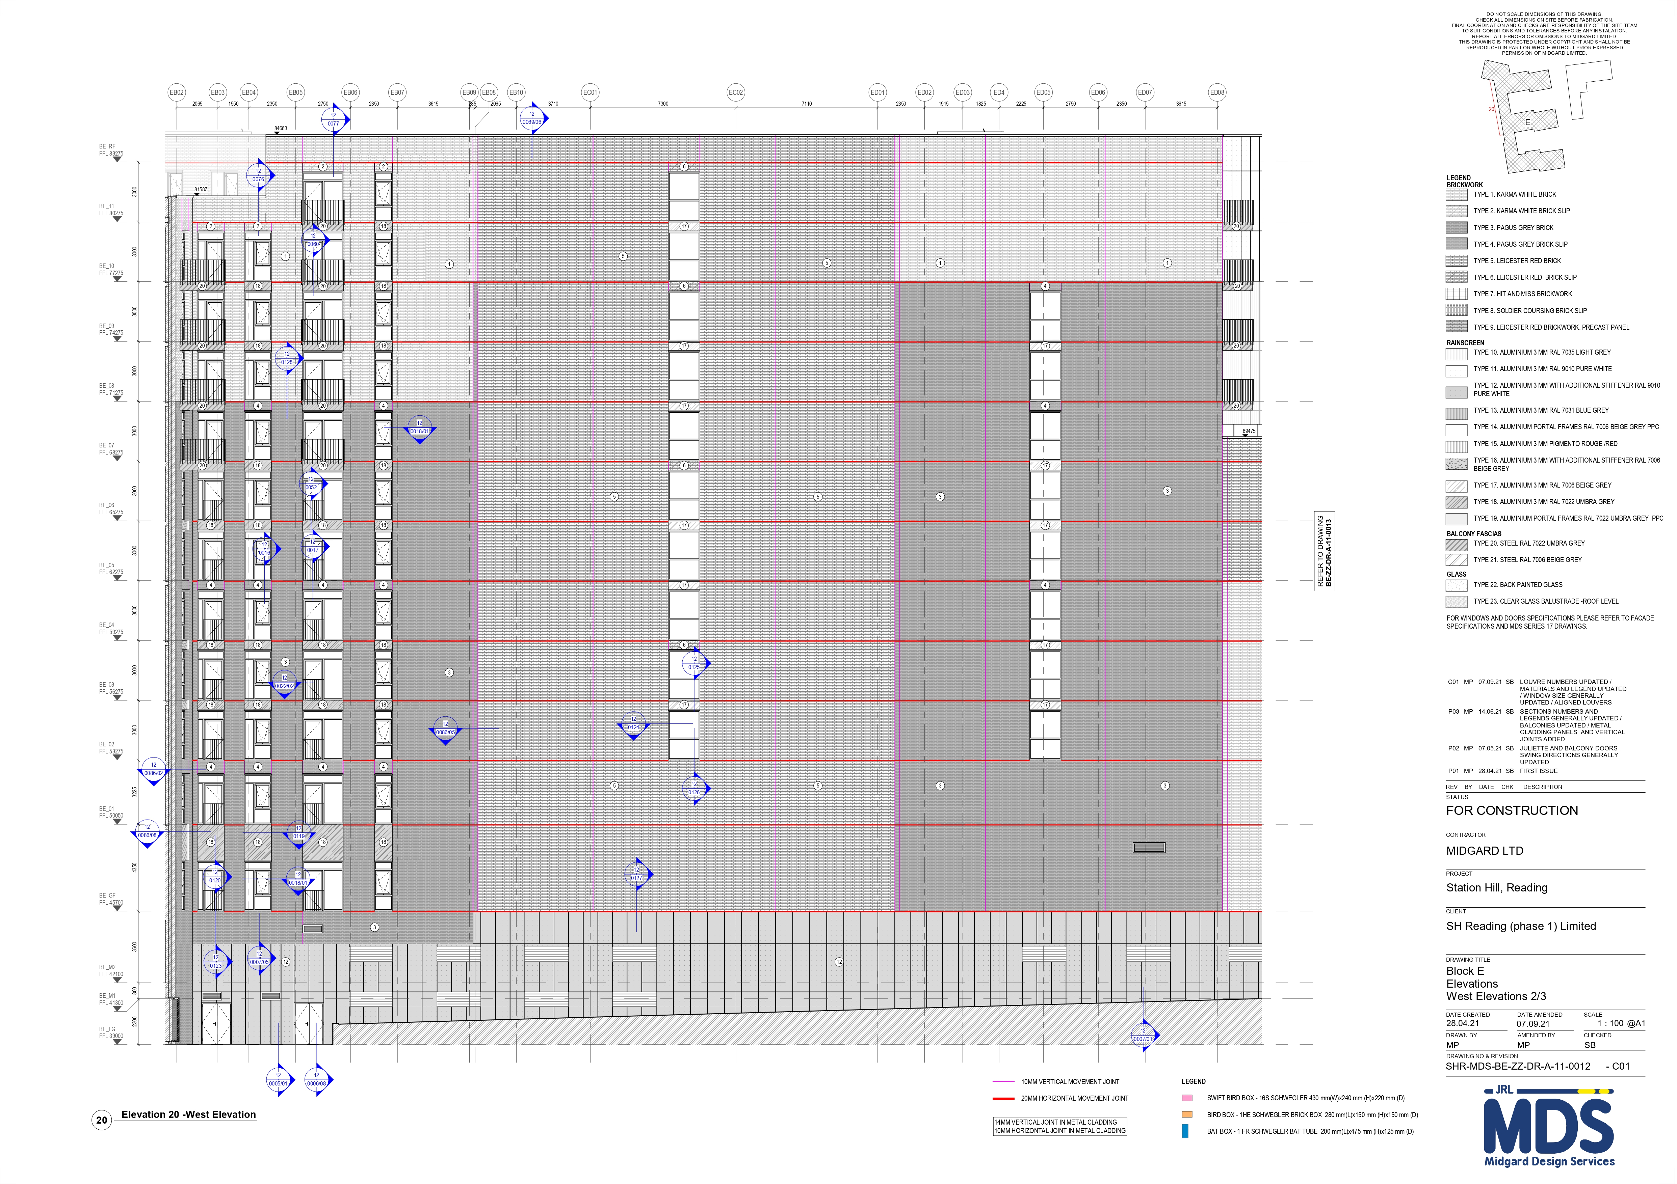
BLOCK E – WEST ELEVATIONS 2/3

Slide 17
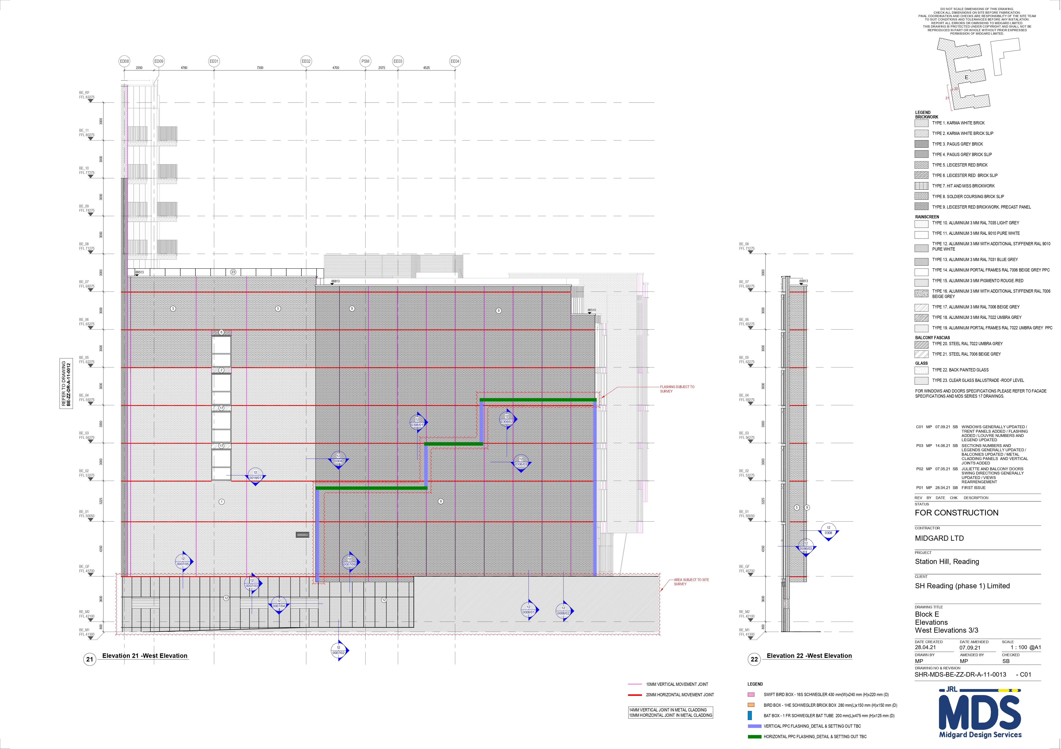
BLOCK E – WEST ELEVATIONS 3/3

Slide 18
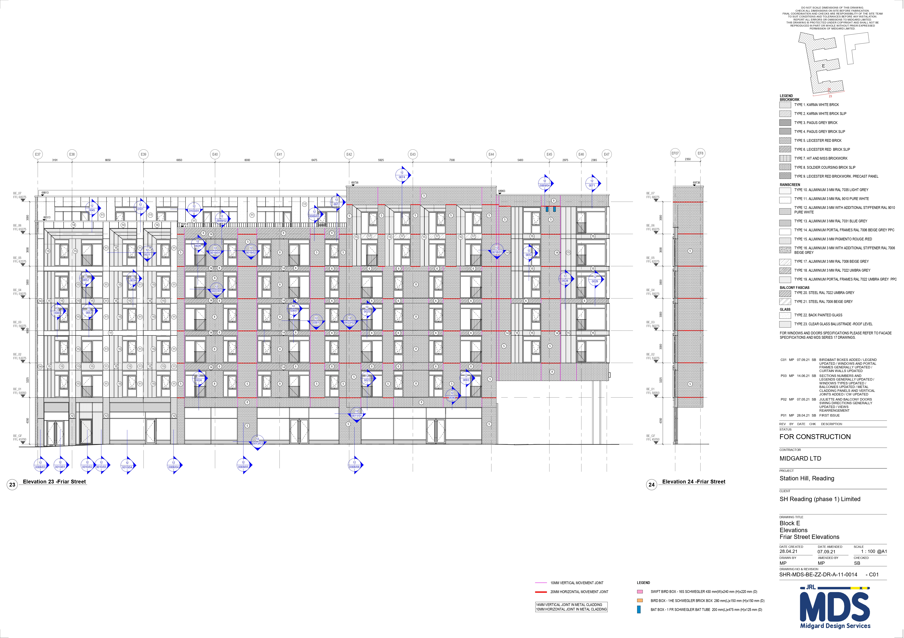
BLOCK E – FRIAR STREET ELEVATIONS

Slide 19
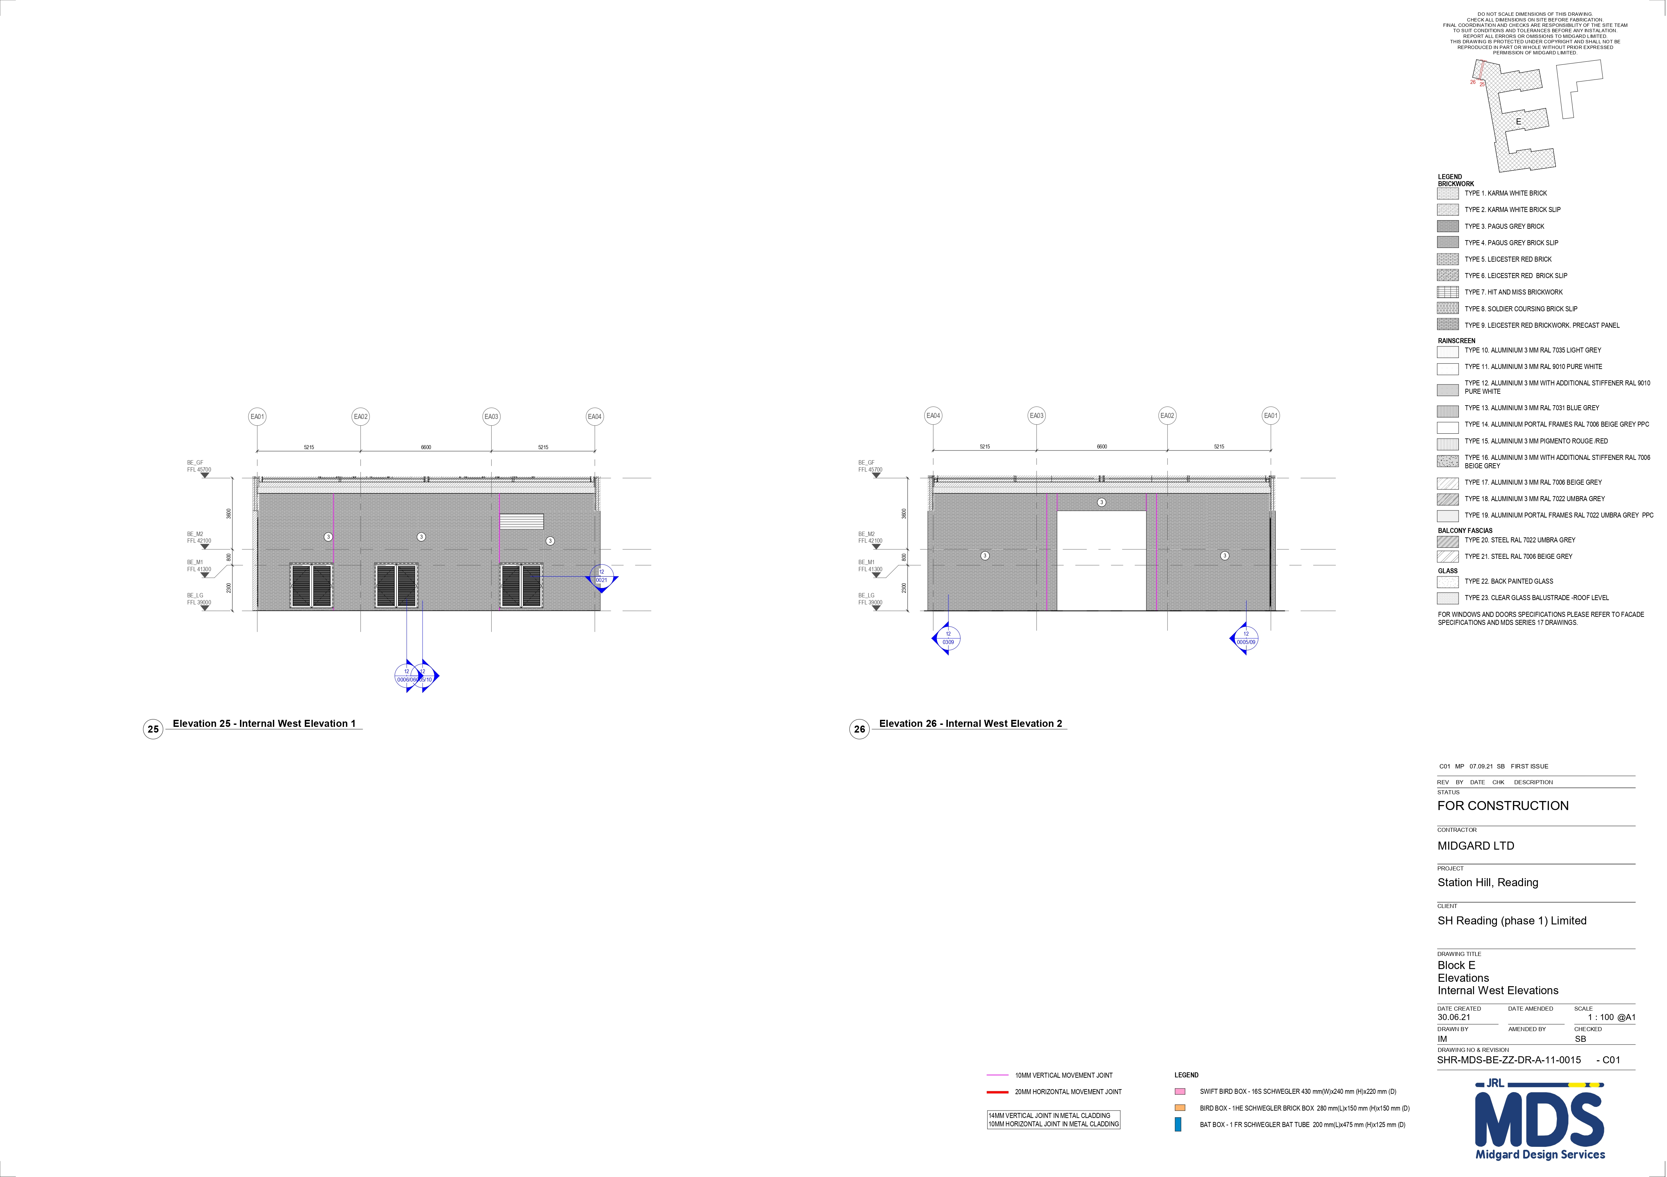
BLOCK E – INTERNAL WEST ELEVATIONS

Slide 20
Block f – general key plan

Slide 21
Block f – gerrard street elevation

Slide 22
Block f – merchant place elevations

Slide 23
Block f – south rear elevation 1/2

Slide 24
Block f – south rear elevation 2/2

Slide 25
Block f – friar walk elevation

