Slide 1
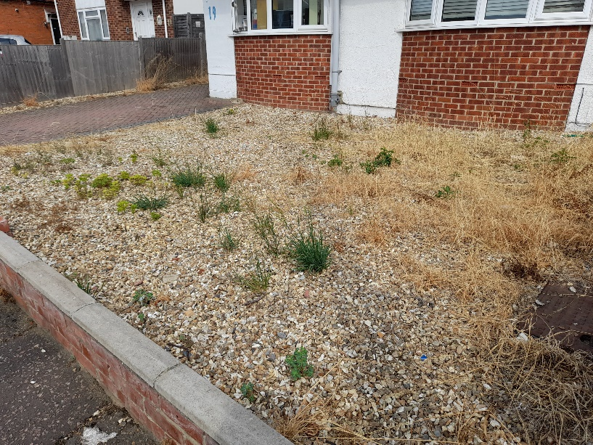
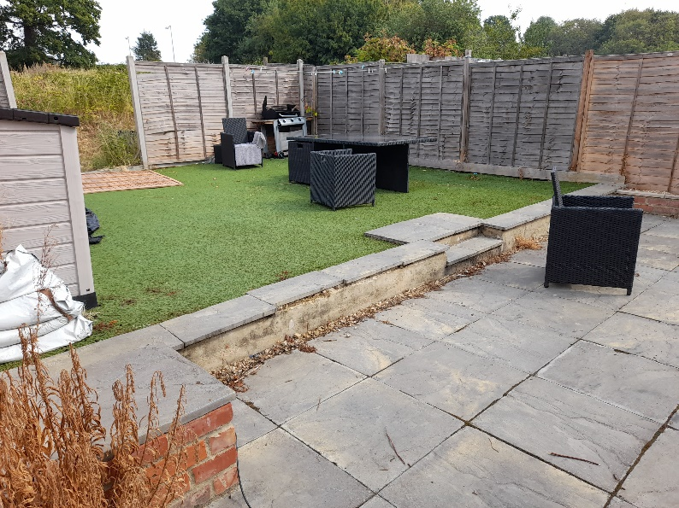

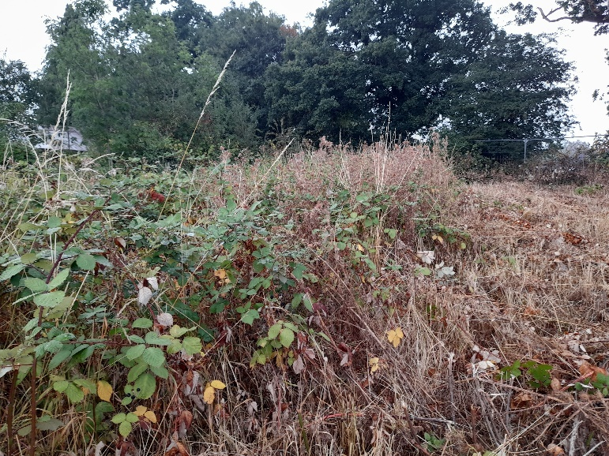
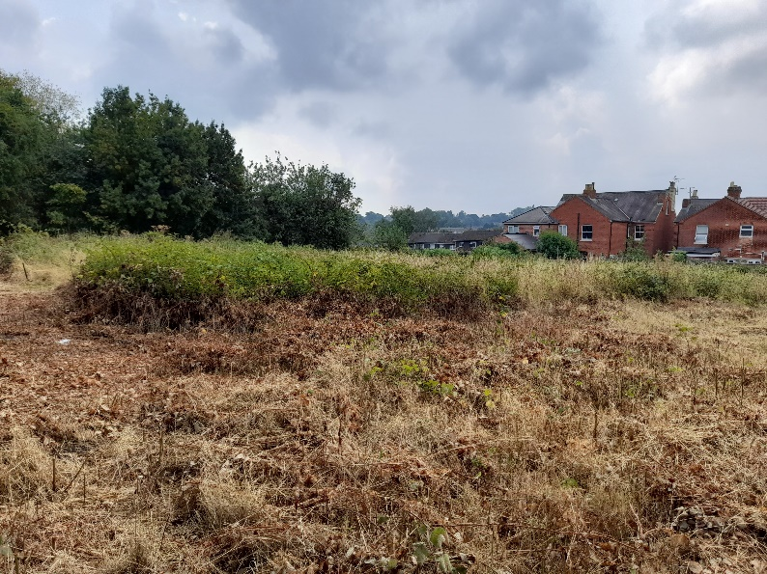
1
2
2
Plate 1 | Ephemeral/ruderal vegetation present at front of property
Plate 2 | u1b Developed land; sealed surface
Plate 3 | h3d Dense bramble scrub
Plate 4 | Mosaic of dense bramble scrub, recently cleared in places.
3
4
Brett Property Lettings Ltd
Land to the Rear of Newcastle Road, Reading,
RG2 7TN
PEA Site Photographs
Ecus Ltd.
Unit 1, Woodlands Business Village, Coronation Road, Basingstoke, RG21 4JX

Slide 2
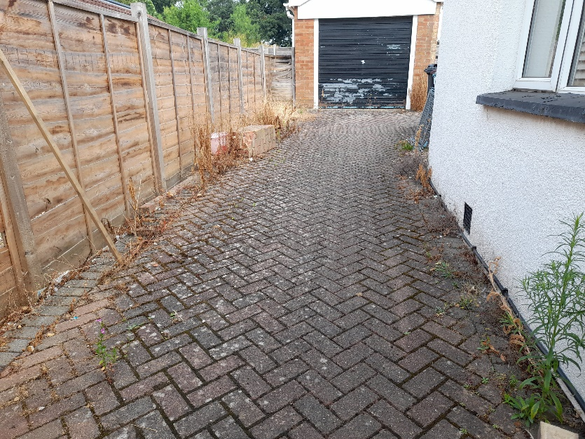
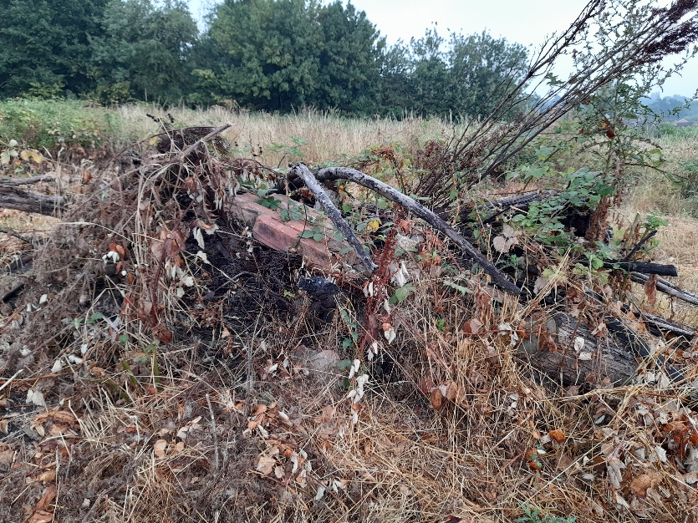
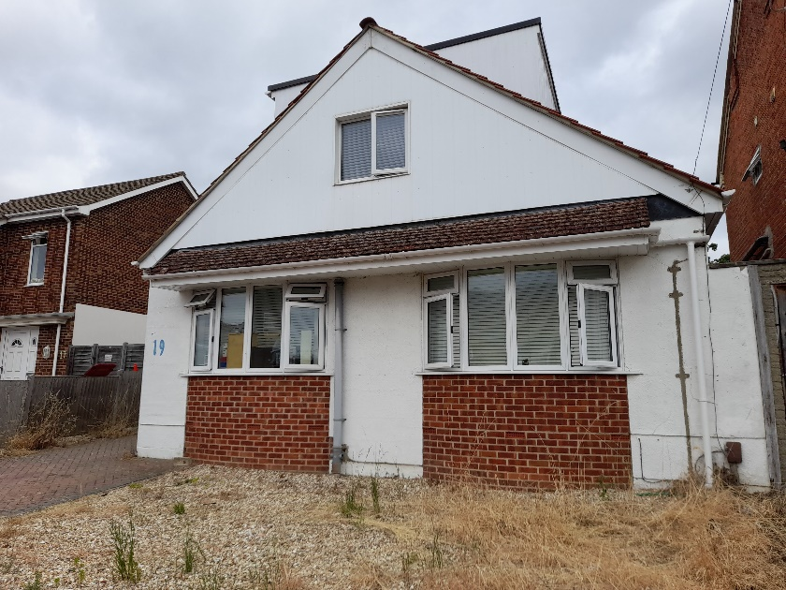
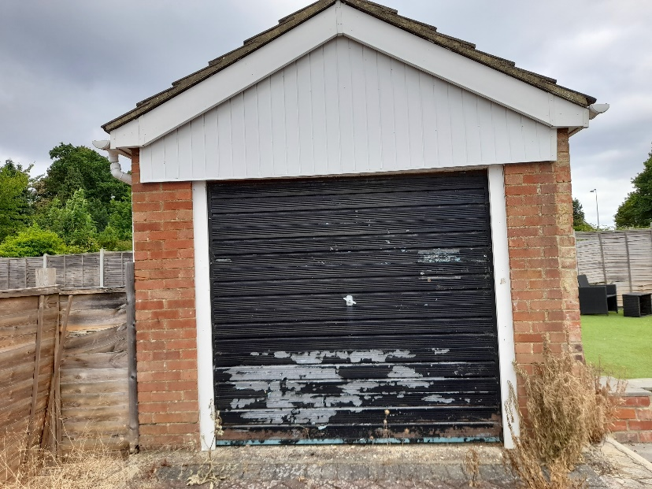
5
6
2
Plate 5 | u1b Developed land; sealed surface
Plate 6 | Discarded rubble, provides suitable shelter for amphibians, reptiles and small mammals
Plate 7 | u1b5 Buildings (B1)
Plate 8 | u1b5 Buildings (B2)
7
8
Brett Property Lettings Ltd
Land to the Rear of Newcastle Road, Reading,
RG2 7TN
PEA Site Photographs
Ecus Ltd.
Unit 1, Woodlands Business Village, Coronation Road, Basingstoke, RG21 4JX

Slide 3
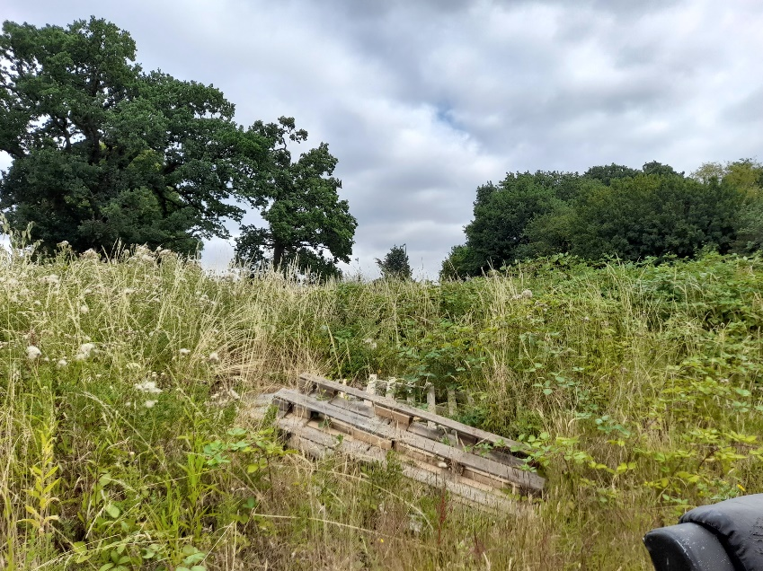
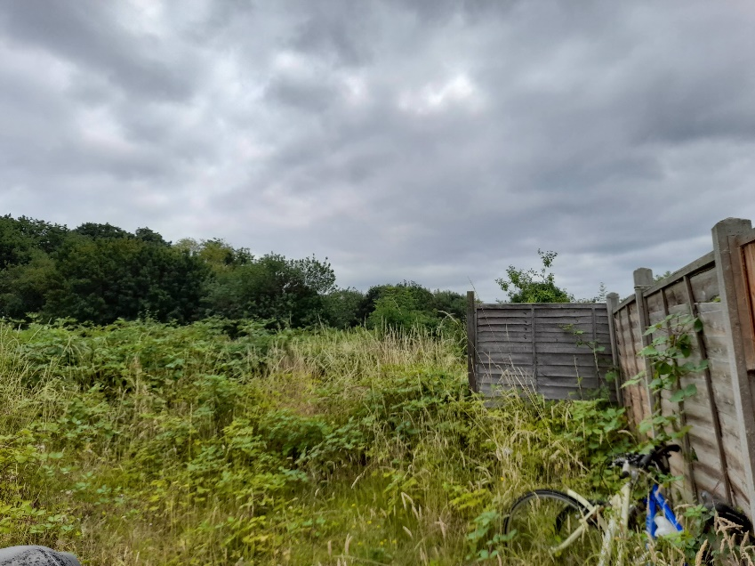
9
10
2
Plate 5 | Dense bramble scrub as pictured in July before some areas cleared. Baseline habitats based on habitats before they were cleared.
Plate 6 | Dense bramble scrub
Brett Property Lettings Ltd
Land to the Rear of Newcastle Road, Reading,
RG2 7TN
PEA Site Photographs
Ecus Ltd.
Unit 1, Woodlands Business Village, Coronation Road, Basingstoke, RG21 4JX

